Slide 1
Data Communication and Networking
Chapter : 2

Slide 2

Communication
Act of giving, receiving and sharing information
Process of exchange of news, views and idea with different people
Transfer of data and information between source and receiver.
Source sends data and recover takes the data
Communication is the process or system that transmit data, instructions and information form one computer to another computer
There are two types of communication : Voice and Data Communication

Slide 3

Voice Communication
Communication by word of mouth
Telephone Communication is most common voice communication
On modern we do some voice call on messenger or other social media platforms

Slide 4
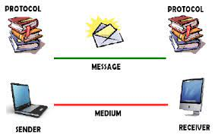
Data Communication
We share data and information and instruction between source and destination
Message can be Video, text , file , software etc
We are connected through various wires and connected to modems and we can convert into analog to digital signals

Slide 5
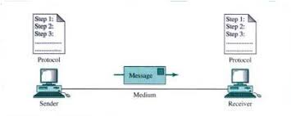
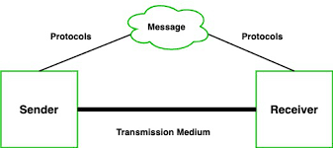
Basic Elements of Data Communication
Message : (Information to be shared )
Sender : (Sends the message)
Receiver : (Takes the Message)
Medium : (Through which message is flowed)
Protocol : (Set of Rules through which communication process happens)

Slide 6
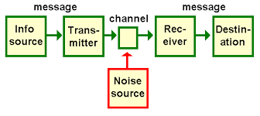
Block Diagram
Source : Sends the message
Transmitter : Encoding or transforming messages into digital form
Transmission System : Channel through which message are flowed
Receiver : Decoding or transforming process is occurred
Destination : Now User get the final and exact message

Slide 7
Elements of Data Communication/ Transmission
Message
    Audio and Video
    Text and Numeric Data
    Image
Sender
Receiver
Medium
Encoding and Decoding
Assignment : Now Explain Block Diagram of Communication and Elements of Communication

Slide 8
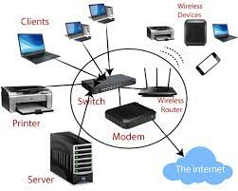
Computer Networking
A computer network is a set of computers sharing resources located on or provided by network nodes.
Group of computer which are interconnected to each other and capable of sharing or transmitting, information, or instructions between two or more computer
Connecting autonomous devices by some medium and to able to communicate is called networking

Slide 9
Advantage of Networking
Shared Information ( Any one can access the information's)
Faster communication ( We can send a lines of text on few seconds)
Backup and Recovery ( WE can store our information on cloud so we can reuse)
Cost effective ( We get cheap resources and reduce information)
Flexibility (We can use or get access from any part of world)

Slide 10
Disadvantage of Networking
Network Failure (Hard to access data)
Security ( Risk of Hacking or Phishing or Virus or Ransomware)
Costly (Router or switch and wires make increase more cost)
Hard to Build ( Need extra professional to create and handle )

Slide 11
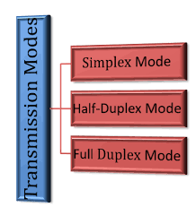
Communication Mode
Simplex
Half Duplex
Full Duplex

Slide 12
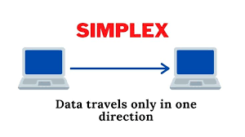
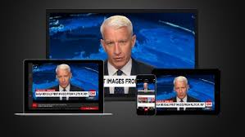
Simplex Mode of Communication
One way communication which have both sender and receiver but message travels one way only
Sender only can send the data receiver cant send
Sender don’t care of message receipt it continuously send the data

Slide 13
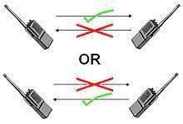
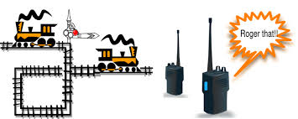
Half Duplex
Half-duplex devices can only transmit in one direction at one time
Data can move in two directions, but not at the same time
WiFi is a half duplex form of data transmission

Slide 14
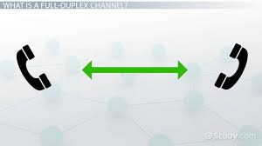
Full Duplex
Simultaneous data transmission and receptions over one channel
A duplex communication system is a point-to-point system composed of two or more connected parties or devices that can communicate with one another in both directions

Slide 15
Network on the based of size
LAN (Local Area Network)
WAN (Wide Area Network)
MAN ( Metropolitan Area Network)

Slide 16
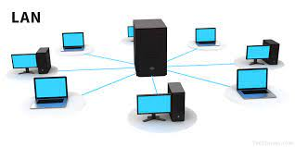
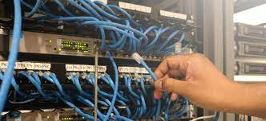
LAN (Local Area Network)
A local area network is a computer network that interconnects computers within a limited area such as a residence, school, laboratory, university campus or office building
Ethernet and WI-FI are the two most common technologies in use for local area networks
Simple LANs generally consist of cabling and one or more switches

Slide 17
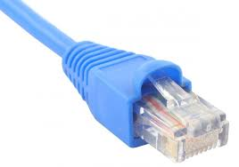
Characteristics of LAN
LAN is a computer network that covers a small geographic area
It is a private network, so an outside regulatory body never controls it.
Cheap and Better Quality
LAN has a higher data transfer rate up to 10 Mbps to 100 Mbps and newer up to 10Gbps

Slide 18
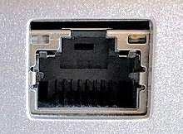
Advantage of LAN
Resource Sharing (WE can share messages very fast)
Easy and Cheap (We use some wires and switches)
Security (Its rare to be cracked )
Centralized Data (We have a server which can pass out data and information)
Computer Identification(We can find some cheater easily)

Slide 19
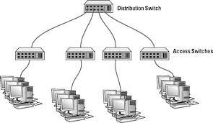
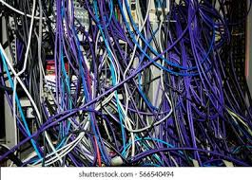
Disadvantage of LAN
Implementation Cost ( Expensive due to large resource material needed)
Malware Spreading (Virus can damage whole eco-system of network)
Server Crash (Most of computer are in depended with server so without its unavailable function cant work properly)
Security (Insider can get access to many of files so issue regarding data security arises)
Area Coverage (LAN are small in size so its rarely of 10 KM long)
Maintenance( We face frequent hardware crashes so we need to check frequently so that work continue smoothly)

Slide 20
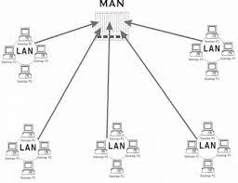
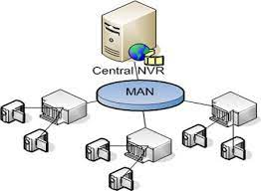
MAN (Metropolitan Area Network)
A Metropolitan Area Network is a class of network which serves a large geographical area between 5 to 100 KM in range
It include various LAN to form a small city network
Computer are connected with wire or wireless medium

Slide 21
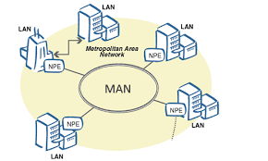
Characteristics of MAN
Network size generally ranges from 10 to 100 km.
Data transfer rate is moderate
Uses both wire or wireless
Can provide both private or public network
Expensive but slower than LAN
Provide uplinks for connecting LANs and WANs and Internet

Slide 22
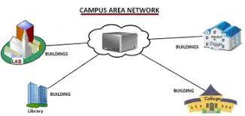
Advantage of MAN
It is wider than LAN
It helps in cost-effective sharing of common resources such as printer etc
It help people interface fast LANs together. This is due to easy implement of links
MAN require fewer resources compare to WAN. This saves the implementation cost

Slide 23
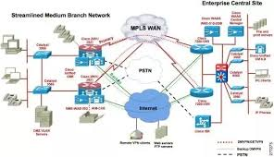
Disadvantage of MAN
More cable require for a MAN connection from one place to another
The data rate is slow compared to LAN
It is difficult to make a system secure from hackers
The large network difficult to manage
It is difficult to secure the network once its becomes large

Slide 24
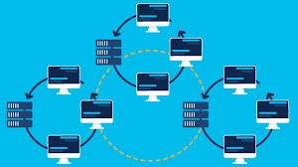
Wide Area Network
A wide area network is a telecommunications network that extends over a large geographic area
WANs can be used to connect cities, states, or even countries
Businesses, as well as schools and government entities, use wide area networks to relay data to staff, students, clients, buyers and suppliers from various locations around the world
This mode of telecommunication allows a business to effectively carry out its daily function regardless of location
The Internet may be considered a WAN

Slide 25
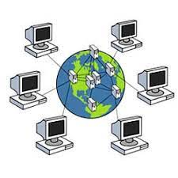
Characteristics of WAN
WANs have a large capacity, connecting a large number of computers over a large area, and are inherently scalable.
They facilitate the sharing of regional resources.
They provide uplinks for connecting LANs and MANs to the Internet.
Communication links are provided by public carriers like telephone networks, network providers, cable systems, satellites etc.
Typically, they have low data transfer rate and high propagation delay, i.e. they have low communication speed.

Slide 26
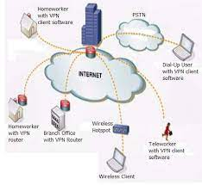
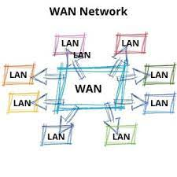
Advantage of WAN
WAN generally covers geographical areas of large proportions
Using WAN means that you can share the data connected to all the devices in the respective network
WAN users can get updated files and data from the servers
Messages travels very fast

Slide 27
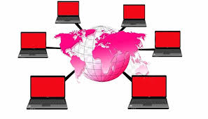

Disadvantage of WAN
Security gap which paves the way for malicious attacks and identity thefts
Data transfer that can be easily accessed by the hackers
Customers often face disconnection issues more frequently
Setting up a WAN requires purchasing of routers, switches and security solutions
Needs assistance from network administrators and technicians

Slide 28
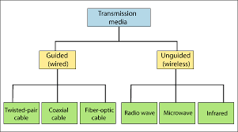
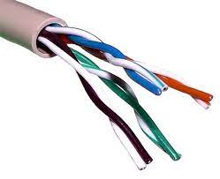
Transmission Medium
A transmission medium is a system or substance that can mediate the propagation of signals for the purposes of telecommunication
A physical path between the transmitter and the receive
There are two types of transmission media : Guided and Unguided

Slide 29
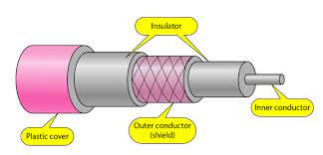
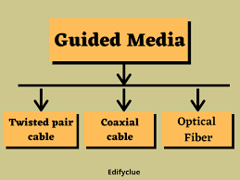
Guided Cable
Guided media, which are those that provide a conduit from one device to another, include Twisted-Pair Cable, Coaxial Cable, and Fibre-Optic Cable
Guided media include phone lines, twisted pair cables, coaxial cables, and optical fibers
Guided media is used for point to point communication

Slide 30
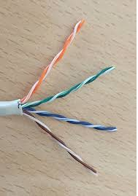
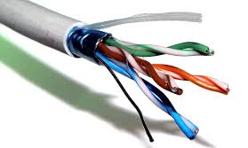
Twisted-Pair Cable
Twisted pair cables have been around for a long time.
mainly invented for voice transmissions
Twisted pair is a widely used medium in networking because it's lighter, cheaper, more flexible, easy to install, and provides greater speeds than coaxial cables
Unshielded twisted pair cable and Shielded twisted pair cable
The unshielded twisted pair cable has 4 pairs of copper wires that are present inside a plastic sheath.
The shielded twisted pair cable is widely used in high-speed networks

Slide 31
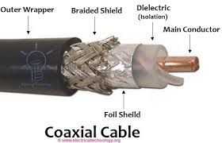
Coaxial Cable
The coaxial cables have a central copper conductor, surrounded by an insulating layer, a conducting shield, and the outermost plastic sheath
There are three insulation layers for the inner copper cable
Coaxial cables have better resistance to cross talk than twisted pair cables.
Coaxial cables are used for long distance communication
Most widely used types of coaxial cables are RG-59 and RG-6 (RG stands for 'radio guide')

Slide 32
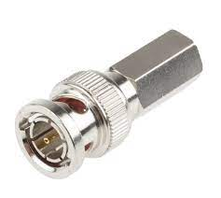
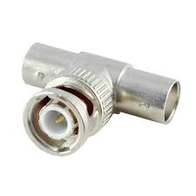
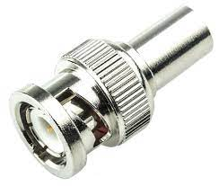
Coaxial Cable
BNC Connector
BNCT Connector
BNC Terminator
Advantage | Disadvantage
High Bandwidth Easy to Locate less susceptible to noise or interference Easy to wire and easy to expand due to flexibility | It is bulky expensive to install for longer distances due to its thickness and stiffness. security is a great concern as it is easy to tap the coaxial cable by breaking it and inserting T-joint

Slide 33
Optical Fiber
Optical fibers use light waves for transmission
well-suited for voice, data, and video transmissions
Fiber optic cables have greater transmission speed, high bandwidth, and the signal can travel longer distances when compared to coaxial and twisted pair cables
Advantage :
  There is zero interference and covers major cities and countries.
  They have high speed and high bandwidth.
  They're highly secure.
Disadvantages:
  Installation and maintenance are difficult.
  Cabling is costly.
  Retrofitting an existing network is difficult, since optical fibers are incompatible with many types of electronic networking equipment.

Slide 34
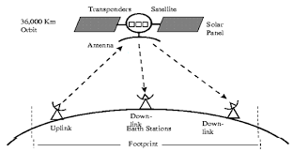
Unguided Media
Used to transmit electromagnetic waves without using any of the physical transmission media
Unguided media type includes air as the media where electromagnetic energy can be flown easily without any intrusion or hindrance
Known as wireless transmission
Eg Radio waves, WIFI, Microwave

Slide 35
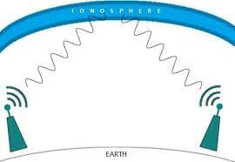
Radio Waves
Radio wave is a type of electromagnetic signal designed to carry information through the air over relatively long distances
Radio waves are referred to as radio frequency (RF) signals
Wi-Fi uses radio waves to transmit information between your device and a router via frequencies
Standard broadcast radio and television, shortwave radio, navigation and air-traffic control, cellular telephony, and even remote-controlled toys

Slide 36
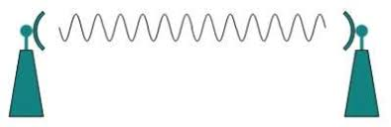
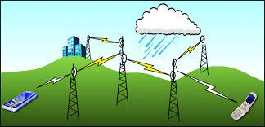
Microwave System
Microwave transmission is the transmission of information by electromagnetic waves with wavelengths in the microwave range of the electromagnetic spectrum.
It allows multiple receivers in a row to receive the signals without interference
Microwaves are often refracted by the atmospheric layers.
Microwaves do not pass through buildings. So, indoor receivers cannot be used effectively

Slide 37
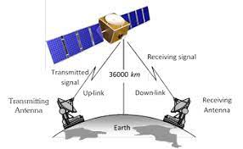
Satellite Communication
Communication satellites are designed to relay several, or more usually many, signals simultaneously
there may be a separate transponder for each carrier; this is typical of broadcasting satellites and of satellites used for distributing television signals to terrestrial broadcasting station
Satellites communicate by using radio waves to send signals to the antennas on the Earth

Slide 38
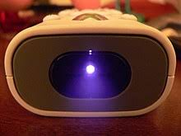
Infrared Waves
Infrared waves are those between the frequencies 300GHz and 400THz in the electromagnetic spectrum
Used in wireless technology devices or systems that convey data through infrared radiation
Infrared technology allows computing devices to communicate via short range wireless signals.

Slide 39
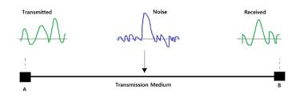
Transmission Impairment
Transmission impairment occurs when the received signal is different from the transmitted signal
Signals that are transmitted at the beginning of the medium are not the same as the signals that are received at the end
Attenuation
Distortion
Noise
Jitter
Echo
Crosstalk
Bandwidth
Number of Receivers

Slide 40
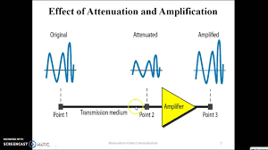
Attenuation
Attenuation is the loss of signal strength in networking cables or connections
Range – over longer distances both wired and wireless transmissions gradually dissipate in strength
Attenuation is caused by passive media components, such as cables, cable splices, and connectors

Slide 41
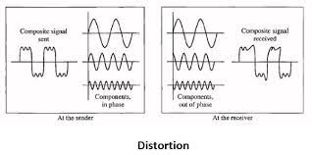
Distortion
Distortion is a term used to describe an interruption of transmitting signals that cause an unclear reception
Distortion is commonly found in sound generated or received by a computer, video or display signals and data cables such as network cables
The main reason behind the cause delay distortion is that the frequency and velocity of the signal in-network medium do not match up

Slide 42
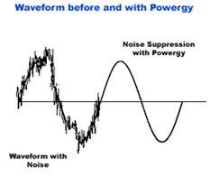
Noise
Noise refers to any energy interference that degrades the quality of a wireless signal
Noise can affect everything from radio transmissions to network speeds.
Any external and unwanted information that interferes with a transmission signal
Noise degrades the quality of signals and data.
Noise occurs in digital and analog systems

Slide 43
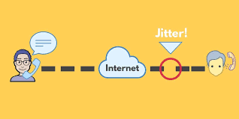
Jitter
Jitter is the variation in time delay between when a signal is transmitted and when it's received over a network connection
Network jitter can be caused by a number of factors and sits in the same bracket of network performance complications as latency, and packet loss
Jitter affects online activities that depend on two-way, real-time communication
Latency : This the time it takes a packet to travel from its source to its destination

Slide 44
Echo
Echo is the local display of data, either initially as it is locally sourced and sent, or finally as a copy of it is received back from a remote destination
An echo is a reflection of sound that arrives at the listener with a delay after the direct sound

Slide 45

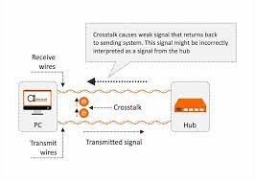
Cross talk
Unwanted signals in a communication channel caused by transference of energy from another circuit
Crosstalk is a disturbance caused by the electric or magnetic fields of one telecommunication signal affecting a signal in an adjacent circuit
if there are two wires in close proximity that are carrying different signals, their currents will create magnetic that induce a weaker signal in the neighbouring wire

Slide 46
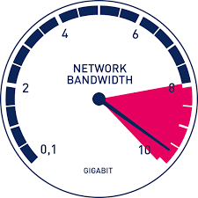
Bandwidth
The maximum amount of data transmitted over an internet connection in a given amount of time
Bandwidth is often mistaken for internet speed when it's actually the volume of information that can be sent over a connection in a measured amount of time – calculated in megabits per second (Mbps)
Bandwidth is measured by how much data can be moved between two points within a network

Slide 47
Number of Receivers
A single message can be for multiple user or a single
As per necessity receivers are calculated

Slide 48
Some Basic Concepts of Network Architecture
Network architecture refers to a network's structural and logical layout
The way network devices and services are structured to serve the connectivity needs of client devices
Types of network architecture are: Peer to Peer network and Client/Server Network

Slide 49

Peer to Peer Network
A peer-to-peer network is one in which two or more PCs share files and access to devices such as printers without requiring a separate server computer or server software
Files can be shared directly between systems on the network without the need of a central server
An advanced P2P network can share files quickly over large distances.

Slide 50

Peer to Peer Network
Advantage
Disadvantage
No need for a network operating system
Does not need an expensive server because individual workstations are used to access the files
Much easier to set up than a client-server network - does not need specialist knowledge
If one computer fails it will not disrupt any other part of the network
Files and folders cannot be centrally backed up
Files and resources are not centrally organised into a specific 'shared area’
There is little or no security besides the permissions
Because each computer might be being accessed by others it can slow down the performance for the user

Slide 51


Client Server Network
Client-server networks are computer networks that use a dedicated computer (server) to store data, manage/provide resources and control user access
The server acts as a central point on the network upon which the other computers connect to
This client server model can be used as a local area network (LAN) or on the internet.

Slide 52

Client Server Network
Advantage
Disadvantage
Client server network is the centralized control (All the necessary information are placed in a single location)
Access controls (only authorized users are granted access)
User needs they can increase the number of resources such as clients and servers
Files are stored in the central server (easy to manage files)
Traffic Congestion (too many clients make request from the same server, result will be crashes or slowing down of the connection)
Main server failure (then the whole network will be disrupted)
High Cost
Need and frequent check of servers

Slide 53
Some basic terms and tools used in Computer Network
IP address
IPv4
IPv6
Subnet mask and Gateway
Gateway
MAC address

Slide 54

IP(Internet Protocol) Address
An IP address is a unique address that identifies a device on the internet or a local network.
IP address is the address where we can locate device but it don’t specify the device address its only internet address
An IP address serves two principal functions: (host and name) host provides the location of the host in the network, and thus the capability of establishing a path to that host.
A name indicates what we seek
We got two types of IP address ie. IPv4 and IPv6

Slide 55
IPv4 (Internet Protocol Version 4)
Whenever a device accesses the Internet, it is assigned a unique, numerical IP address such as 99.48. 227.227
IPv4 was the first version deployed for production on SATNET in 1982 and on the ARPANET in January 1983
The IPv4 address is a 32-bit number that uniquely identifies a network interface on a machine
An IPv4 address is typically written in decimal digits, formatted as four 8-bit fields that are separated by periods
We do have address from 0.0.0.0 to 255.255.255.255( 00000000.00000000.00000000.0000000 to 11111111.11111111.11111111.11111111)
We have 2^32 ie 4.2 billion hosts

Slide 56
Classes of IP address
Class | Description | IP Range | Private IP | No of host
A | Class A addresses are for networks with large number of total hosts | 0.0.0.0 to 127.0.0.0 | 10.0.0.0 to 10.255.255.255 | 16,777,214
B | Class B addresses are for medium to large sized networks | 128.0.0.0 to 191.255.0.0 | 172.16.0.0 to 172.16.255.255 | 65,534
C | Class C addresses are used in small local area networks (LANs). | 192.0.0.0 to 223.255.255.0 | 192.168.0.0 to 192.168.255.255 | 254
D | Class D IP addresses are not allocated to hosts and are used for multicasting | 224.0.0.0 to 239.255.255.255 | N/A | N/A
E | Class E IP addresses are not allocated to hosts and are not available for general use | 240.0.0.0 to 255.255.255.255 | N/A | N/A

Slide 57
IPv6
An IPv6 address is a 128-bit alphanumeric value that identifies an endpoint device in an Internet Protocol Version 6 (IPv6) network
IPv6 is the successor to a previous addressing infrastructure, IPv4, which had limitations IPv6 was designed to overcome
It use hexadecimal number
More secure to transmit data
Example: 1050:0000:0000:0000:0005:0600:300c:326b

Slide 58
Subnet Mask
Every device has an IP address with two pieces: the client or host address
IP addresses are either configured by a DHCP(Dynamic Host Control Protocol) server or manually configured (static IP addresses)
The subnet mask splits the IP address into the host and network addresses, thereby defining which part of the IP address belongs to the device and which part belongs to the network
A subnetwork or subnet is a logical subdivision of an IP network
A practice of dividing a network into two or more networks is called subnetting

Slide 59


Slide 60
Subnet Mask
A subnet mask is a 32-bit number created by setting host bits to all 0s and setting network bits to all 1s.
The subnet mask separates the IP address into the network and host addresses and setting network bits to all 1s
The “255” address is always assigned to a broadcast address, and the “0” address is always assigned to a network address
Class A: 255.0.0.0
Class B: 255.255.0.0
Class C: 255.255.255.0

Slide 61


Gate Way
The gateway converts information, data or other communications from one protocol or format to another
A router perform some of the functions of a gateway.
An Internet gateway can transfer communications between an enterprise network and the Internet
A 'gateway server' acts as a middleman, brokering transactions between a client computer and another server

Slide 62

Mac Address (Media Access Control Address )
Is a unique identifier assigned to a network interface controller (NIC) for use as a network address in communications within a network segment.
This use is common in most IEEE 802 networking technologies, including Ethernet, Wi- Fi, and Bluetooth
A unique number which is used to track a device in a network
Mac address is also used in Wi-Fi networks at the airport for a specific device in order to identify it.
A universally administered address is uniquely assigned to a device by its manufacturer
Example of Mac Address : 00:00:5e:00:53:af.

Slide 63


Internet
The Internet is a vast network that connects computers all over the world.
People can share information and communicate from anywhere with an Internet connection
It consists of public, private, academic, business, and government networks of local to global scope, linked by a comprehensive arrangement of electronic, wireless, and optical networking technologies
No one own internet because we are connected to various MAN LAN to create a huge WAN
Internet helps us to reduce a lot of communication cost by Email or Video call features
We use FTP( File Transfer Protocol) Remote LOGIN (TELNET), WWW, e-Mail or BLOGS and so on…………

Slide 64


Intranet
An intranet is a computer network for sharing information, easier communication, collaboration tools, operational systems, and other computing services
Intranets are predominantly used by employees to search for information, communicate across an organization, and manage workflows
A private network used by an organization
The intranet works on the same principle as the Internet(uses same protocols like TCP/IP for communication, FTP protocol for file transfers, and HTTP for web queries)

Slide 65


Extranet
The extranet is a private network that uses the internet that allows people outside a business – partners, vendors or authorised customers – to access business information
As the extranet is a private network, this ensures that the data is safer than if it was shared over a normal internet connection

Slide 66

Difference between Intranet and Extranet

Slide 67

Difference between Internet and Intranet

Slide 68
Network Tools
Packet tracer
Remote Login Tools

Slide 69


Packet Tracer
Packet Tracer is a cross-platform visual simulation tool designed by Cisco Systems that allows users to create network topologies and imitate modern computer networks
The software allows users to simulate the configuration of Cisco routers and switches using a simulated command line interface
Packet Tracer helps students and instructors create their own virtual “network worlds” for exploration, experimentation, and explanation of networking concepts and technologies
Cisco Certified Network Associate (CCNA) training we need to practice Packet Tracer

Slide 70

Uses of Packet Tracer
Allow you to configure and build networks with user free drag and drop
We can practice and learn skills that we can create and solve network
Support world wide protocols technologies CCNA routing, security, and other IT resources
We can monitor packet transfer logistics data transfer and more in real time
Allow us to interact with ping, randomly IP assign and many more
We can get real time feedback to enjoy comprehensive learning experience
We use more API with multiple plugins
Much easier for us to share ideas, practice and learn

Slide 71
Networking Connecting Devices
Network Adapter
Modem
Hub
Switch
Bridge
Repeater
Router
Gateway
Bluetooth
Infrared
WIFI

Slide 72


Network Adapter
A network adapter is the component of a computer's internal hardware that is used for communicating over a network with another computer
It enables a computer to connect with another computer, server or any networking device over an local area network (LAN) connection
The network adapter allows the device to communicate over the local area network (LAN), connecting to the internet or to other computers.
Wireless network adapters, such as those on laptop computers and tablets, take the computer's signals and convert them into radio waves that transmit via antenna (visible or hidden).
NIC are inserted in motherboard
Support Data transfer of 10,100 to 1000 Mbps

Slide 73


Modem
A modulator-demodulator, or simply modem, is a computer hardware device that converts data from a digital format into a format suitable for an analog such
purpose of the modem is to provide you with internet access
A Wi-Fi modem is a single combined device that translates Internet data packets via the modem and sends it through wirelessly to devices in your home via the router

Slide 74


HUB
A network hub is a node that broadcasts data to every computer or Ethernet-based device connected to it
hub is a physical layer networking device which is used to connect multiple devices in a network.
A Hub is a broadcast device that sends data from one node to all nodes
A USB hub is great for charging a number of different devices at once

Slide 75


Switch
A switch is a device in a computer network that connects other devices together
Multiple data cables are plugged into a switch to enable communication between different networked devices
connect multiple devices, such as computers, wireless access points, printers, and servers; on the same network within a building or campus
A switch enables connected devices to share information and talk to each other.
We can 4 port or 128 or higher ports

Slide 76

Bridge
Bridge is a device used to separate a network into tow sections
Computer networking device that creates a single, aggregate network from multiple communication networks or network segments
Basic role of bridges in network architecture is storing and forwarding frames between the different segments that the bridge connect
It is necessary to divide networks into subnets to reduce the amount of traffic on each larger subnet or for security reasons

Slide 77


Repeater
A repeater is an electronic device in a communication channel that increases the power of a signal and retransmits it, allowing it to travel further.
It amplifies the signal, it requires a source of electric power
Wi-Fi repeater, extender, or booster is a device that forwards wireless signals from the router to cover a larger area, such as multiple floors of a house.
Repeater creates a new network based on signals from the originating network, and the clients that connect to the repeater are thus on a separate network

Slide 78


Router
Router is responsible for organising communication between computer networks
A router takes data packets from devices and directs them to the right place
Routers often use IP addresses to know where to look for information
Routers allow your computers to access the internet or request files from a server
Interior Routing is used to do TCP/IP protocol inside the organization
Exterior Routing is for autonomous routing

Slide 79

Gateway
A gateway is a piece of networking hardware or software used in telecommunications networks that allows data to flow from one discrete network to another
The gateway converts information, data or other communications from one protocol or format to another
Helps to communicate to a remote network or an autonomous system that is out of bounds for the host network nodes
Router Performs gateway to connect autonomous system

Slide 80

Bluetooth
Bluetooth is a radio communication technology that enables low-power, short distance wireless networking between phones, computers, and other network devices
It is used to create a wireless personal area network for data transfer up to a distance of 10 meters
Bluetooth is only used to connect your devices to each other

Slide 81

Infrared
Electromagnetic radiation (EMR) with wavelengths longer than those of visible light
Infrared radiation is emitted or absorbed by molecules when changing rotational-vibrational movements
Used for short distance communication where light can reached

Slide 82


Wi-Fi
Wi-Fi network uses a radio frequency signal instead of wires to connect your devices - such as computers, printers and smartphones - to the Internet and each other
Based on IEEE(Institute of Electrical and Electronics Engineers)802.11
The Wi-Fi signal can be picked up by any wireless-capable device such as a laptop or tablet within a certain distance in all directions
Sends this data via internet connections (the highway) through the air to wide area networks and on to non-wired computers
general rule of thumb in home networking says that Wi-Fi routers operating on the 2.4 GHz band can reach up to 150 feet indoors and 300 feet outdoors.

Slide 83
Network Topology
Ring
Bus
Star
Mesh
Hybrid
Tree

Slide 84


Ring Topology
A ring network is a network topology in which each node connects to exactly two other nodes, forming a single continuous pathway for signals through each node – a ring
Each networked device is connected to two others, like points on a circle
Most ring topologies allow packets to travel only in one direction, called a unidirectional ring network
Advantage:
All data flows in one direction, reducing the chance of packet collisions.
A network server is not needed to control network connectivity between each workstation.
Data can transfer between workstations at high speeds.
Disadvantage
Due to the Uni-directional Ring, a data packet (token) must have to pass through all the nodes.
If one workstation shuts down, it affects whole network or if a node goes down entire network goes down.
It is slower in performance as compared to the bus topology.

Slide 85

Bus Topology
Bus topology, also known as line topology, is a type of network topology in which all devices in the network are connected by one central RJ-45 network twisted pair cable or coaxial cable
The single cable, where all data is transmitted between devices, is referred to as the bus, backbone, or trunk
Data is sent up and down the backbone until it reaches the correct node
Advantage:
Easy to connect a computer or peripheral to a linear bus.
• Requires less cable length than a star topology.
Disadvantage :
Entire network shuts down if there is a break in the main cable.
• Terminators are required at both ends of the backbone cable.
• Difficult to identify the problem if the entire network shuts down.
• Not meant to be used as a stand-alone solution.

Slide 86


Star Topology
Star topology is a network topology in which each network component is physically connected to a central node such as a router, hub or switch
When the central node receives a packet from a connecting node, it can pass the packet on to other nodes in the network
used to ease the probabilities of network failure by connecting all of the systems to a central node
Advantage:
Centralized network.
Very reliable.
Easily manageable
No point-to-point connections
Multiple stars can be created to extend the network’s reach
Disadvantage :
High cost
Everything depends on the central device
High maintenance
Wireless systems have low data transfer rates

Slide 87

Mesh Topology
Mesh topology is a type of networking in which all the computers are inter-connected to each other
The connections between devices take place randomly
Connected nodes can be computers, switches, hubs, or any other devices
Each node is capable of sending messages to and receiving messages from other nodes
Advantage:
Mesh Topology can manage a high level of traffic
Failure of one single device does not affect the network
Data transmission is consistent since failure in the network does not disrupt the process.
Disadvantage :
High cost
Time-consuming to build and maintain
Each node has an increased workload
High risk of redundant connection.

Slide 88


Tree Topology
Advantage:
It is a combination of bus and star topology.
It provides high scalability, as leaf nodes can add more nodes in the hierarchical chain.
Other nodes in a network are not affected, if one of their nodes get damaged.
It provides easy maintenance and fault identification.
Tree Topology is a topology which is having a tree structure in which all the computer are connected like the branches which are connected with the tree.
Tree topology is called as a combination of a Bus and Start network topology
Tree topology is suitable for large networks, spread into many branches
Disadvantage :
Large cabling is required as compared to star and bus topology.
On the failure of a hub, the entire network fails.
Tree network is very difficult to configure than other network topologies.

Slide 89


Hybrid Topology
Hybrid topology is an integration of two or more different topologies to form a resultant topology which has many advantages (as well as disadvantages) of all the constituent basic topologies rather than having characteristics of one specific topology
a home network that uses both Wi-Fi and Ethernet cables to connect computers is a hybrid
Advantage:
It is extremely flexible.
It is very reliable.
Handles large volume of traffic.
It is used for create large network.
Can be modified as per requirement.
Disadvantage :
It is a type of network expensive.
Design of a hybrid network is very complex.
Installation is a difficult process.
Usually hybrid architectures are usually larger in scales so they requires a lot of cables in installation process

