Slide 1
Computer Software and Operating System
Chapter 3

Slide 2
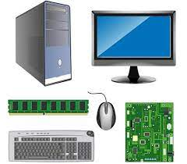
Introduction
Computer System is made up of hardware and software
Physical Parts which we can see or touch are hardware(input devices, output devices, CPU, processor, wires etc)
Software is defined as a computer program together with an associated documentation that describes the program and how they are used(soul of computer)
Hardware are completely depended with software
Computer can only do certain program if they have certain set of instructions

Slide 3
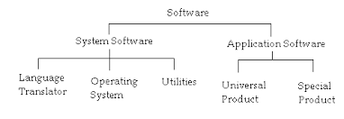
Categories of software

Slide 4
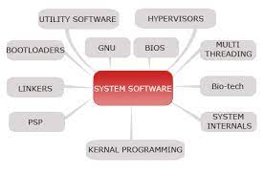
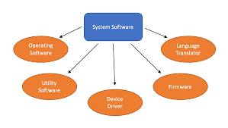
System Software
System software is a type of computer program that is designed to run a computer's hardware and application programs
Helps application programs to execute correctly.
System software controls a computer's internal functioning, chiefly through an operating system, and also controls such peripherals as monitors, printers, and other input devices
System Software
Operating System
Language Translator
Utility
Firmware
Driver

Slide 5
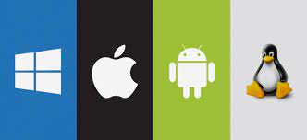
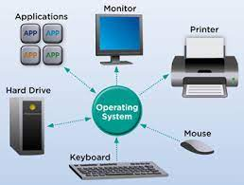
Operating System
An operating system (OS) is system software that manages computer hardware, software resources, and provides common services for computer programs.
It acts as a bridge for the interface between man and machine
Operating system manages the software side of a computer and controls programs execution
Without OS normal people can’t use computer
Operating System make computer easy to use

Slide 6
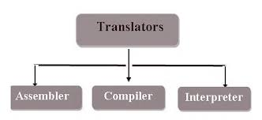
Translator( Language Processor)
A translator or programming language processor is a generic term that can refer to anything that converts code from one computer language into another
These source codes need to translate into machine language to be executed because they cannot be executed directly by the computer

Slide 7
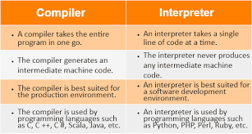
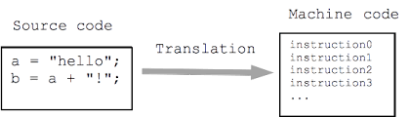
Types of Translator
Assembler ( Translate assembly language into machine level language)
Compiler ( Convert high level language into machine level language and translate whole file at a time)
Interpreter ( Interpreter also convert high level language into machine level but it translate one statement at a time)

Slide 8
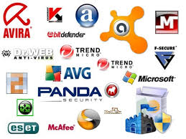
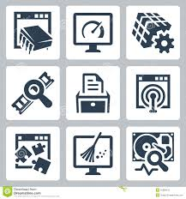
Utility Software
Utility Software is system software that helps to maintain the proper and smooth functioning of a Computer System
It assists the Operating System to manage, organize, maintain, and optimize the functioning of the computer system
Utility Software performs certain tasks like virus detection, installation, and uninstallation, data backup, deletion of unwanted files
Examples : antivirus software, file management tools, compression tools, disk management tools, etc.

Slide 9
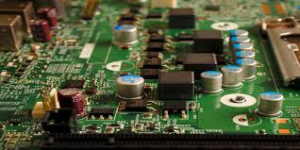
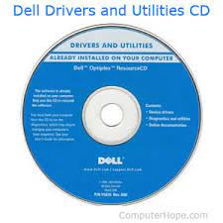
Firm Ware
Driver
Firmware is a specific class of computer software that provides the low-level control for a device's specific hardware
It provides the necessary instructions for how the device communicates with the other computer hardware
Firmware is typically stored in the flash ROM of a hardware device
a device driver is a computer program that operates or controls a particular type of device
A driver communicates with the device through the computer bus or communications subsystem to which the hardware connects
Drivers are hardware dependent and operating-system-specific

Slide 10
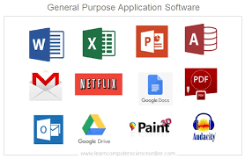
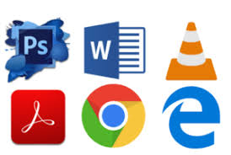
Application Software
Application software (app), is software that performs specific tasks for an end-user
An application program is a computer program designed to carry out a specific task other than one relating to the operation of the computer itself, typically to be used by end-users
Applications software is capable of dealing with user inputs and helps the user to complete the task
First user deal with system software after that he/she deals with application software
It could be offline or online or small or big
Types of Application Software : Tailored and Packed

Slide 11
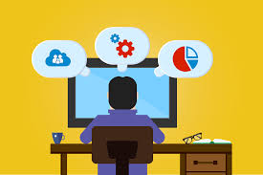
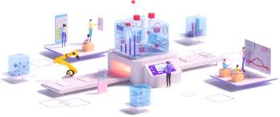
Tailored( Customized)
is software that is specially developed for some specific organization or other use
helps meet unique requirements at a cost competitive with purchasing, maintaining and modifying commercial software
Made for specific team or organization
Advantage | Disadvantage
It Increases productivity. Specific needs of your enterprise. It's more secure against external threats. | Initial Costs Waiting Time. It can’t do many tasks

Slide 12
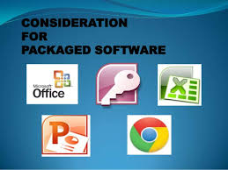
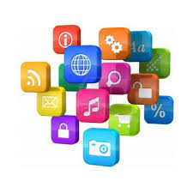
Package Software
Multiple software programs bundled together and sold as a set
A software package is simply multiple applications or code modules that work together to meet various goals and objectives
A software package is simply multiple applications or code modules that work together to meet various goals and objectives

Slide 13

Package Software
Advantage
Disadvantage
Simplified decision making
Increased productivity
Improved data security
Increased sales potential
Enhanced analysis
Need extra manpower
Costly
Need mores support
Time Consuming

Slide 14
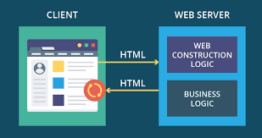
Web Based Application
A web-based application is any program that is accessed over a network connection using HTTP, rather than existing within a device's memory
A web application is application software that runs on a web server, unlike computer-based software programs that are run locally on the operating system of the device
Examples: Google Docs, Google Slides, Google Sheets and cloud storage
Advantage | Disadvantage
Accessibility across devices for users Customization for different devices. Integration with other systems. Increased flexibility Platform Support | Performance Security Web Issues Internet Dependence

Slide 15

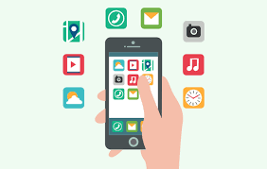
Mobile Application
A mobile application (app) is a computer program or software application designed to run on a mobile device such as a phone, tablet, or watch
Mobile applications frequently serve to provide users with similar services to those accessed on PCs
Means for accessing applications from remote locations and with mobile devices, for collaborating and sharing files without computers
We simply download files from play stores or app store as per their platform

Slide 16
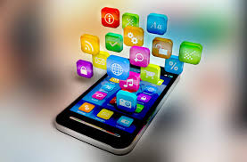
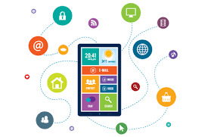
Mobile Application
Assignment:
Write a difference between
System Software and Application Software
Difference between tailored and customized software
Software and Hardware
Advantage
Disadvantage
Ease of access
Data capture
Communication
Productivity
Lack of focus
Cost
Complicated
Updating

Slide 17
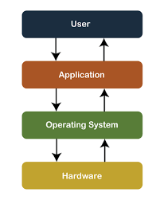
Concept of Operating System
An operating system (OS) is system software that manages computer hardware, software resources, and provides common services for computer program
An operating system is a software which performs all the basic tasks like file management, memory management, process management, handling input and output, and controlling peripheral devices such as disk drives and printers
It acts as a bridge for the interface between man and machine

Slide 18
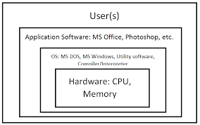
Organization of Operating System
Roles of OS
Accept input form user through various input devices
Send to output devices
Store and Save files
Monitor and control or coordinate hardwware4 devices
Help to load any program
Help user to develop program
Operating System is an intermediate software layer between the user and computer hardware
OS identifies the various boundaries between its components and the boundaries between these components and user programs
Objectives of OS
Easily add or remove program
Manage program files or folders
Provide proper memory division
There wont be any barriers on running any application

Slide 19
Functions of Operating System
Input/Output management (OS provide to handle all request regarding input and output process, It also load many drivers as per necessary)
File Management ( OS provide us easy to add remove any sorts of file which our programs support)
Memory Management (Memory division as per our request OS fragment memory)
Protection and Security (OS Continuously monitor for Virus Threat or other threat)
Process Management (OS handle all steps properly so that all task completed properly)
Interrupt Handling (We may get some hardware issue when we are doing so OS alert by providing notification or saving our data)
Paging( Some time entire tasks cant be displayed on a single page so OS do page break so that we can see a clear view)

Slide 20
Functions of Operating System
Virtual Memory(Virtual memory is a section of volatile memory created temporarily on the storage drive)
Event Logging(Tracking what we have changed or to troubleshoot if something wrong)
Process Scheduling( Works on multi-tasking process in which different software are running concurrently Types: Primitive (Limited time) and Non-Primitive (Unlimited Time))
User Interface (to the part of an operating system, program, or device that allows a user to enter and receive information so that hardware and software parts are used)
Command Interpreter (CMD control entire GUI background)

Slide 21
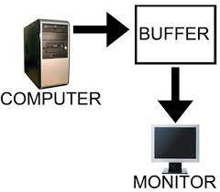
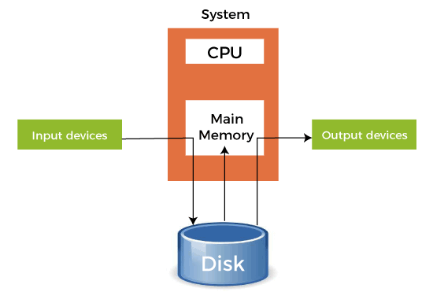
Some Technical Terms
Spooling
Buffering
Spooling stands for "Simultaneous Peripheral Operations Online“
Spooling is a process in which data is temporarily held to be used and executed by a device, program, or system
Data is sent to and stored in memory or other volatile storage until the program or computer requests it for execution.
In printer, the documents/files that are sent to the printer are first stored in the memory or the printer spooler
Buffering is the process of preloading data into a reserved area of memory that's called a buffer
A buffer in a computer environment means that a set amount of data is going to be stored in order to preload the required data right before it gets used by the CPU.
buffer stores transmitted data temporarily as it is going between devices or between a device and an app
Used to store or hold the data temporarily

Slide 22
Types of Operating System
Based on mode of user
(Number of user that can use the computer resources at a time is user mode)
Single User
Only user can use the computer
Multi User
Multiple can use the computer

Slide 23
Based on Processing Method
Batch processing
Multi Programming
Multi Tasking
Multi Processing
Real Time OS
Distributed OS

Slide 24
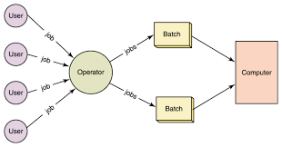
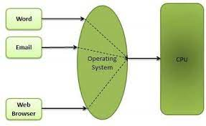
Based on Processing Method
Batch Processing
Multi Programming
The process by which a computer completes batches of jobs, often simultaneously, in non-stop, sequential order
Batch processing is the processing of transactions in a group or batch
Batch processing use cases can be found in banks, hospitals, accounting, and any other environment where a large set of data needs to be processed.
Multiprogramming is a rudimentary form of parallel processing in which several programs are run at the same time on a uniprocessor
the technique of utilizing several programs concurrently in a single computer system via multiprocessing
User can use MS-Excel , download apps, transfer data from one point to another point, Firefox or Google Chrome browser, and more at a same time

Slide 25

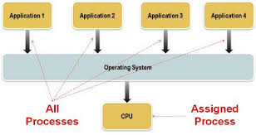
Multi Tasking
A multitasking operating system (OS) is one that can work on more than one task at a time by switching between the tasks very rapidly
This allows the system to switch smoothly between tasks.
It is controlled by the operating system, which loads programs into the computer for processing and oversees their execution until they are finished.
There are two type of multitasking: Preemptive(parcels out CPU time slices to each program) and cooperative (each program can control the CPU for as long as it needs it)

Slide 26
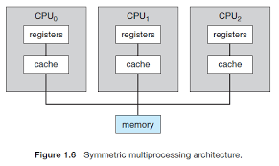
Multi Processing
Multiprocessing, in computing, a mode of operation in which two or more processors in a computer simultaneously process two or more different portions of the same program (set of instructions)
Each CPU contains a copy of the OS, and these copies communicate with one another to coordinate operations
These operating systems include Windows NT, 2000, XP, and Unix.

Slide 27
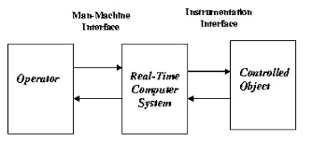
Real time Operating System(RTOS)
For real time applications that processes data and events that have critically defined time constraints
System which can predict the outer world
Real-time operating systems are commonly found and used in robotics, cameras, complex multimedia animation systems, and communications.
Real-time operating systems are event-driven and preemetive, meaning the OS is capable of monitoring the relevant priority of competing tasks, and make changes to the task priority
Routing Fax etc

Slide 28
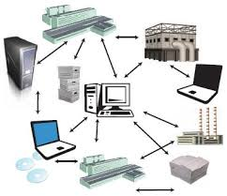
Distributed Operating System
A distributed operating system is system software over a collection of independent, networked, communicating, and physically separate computational nodes
They handle jobs which are serviced by multiple CPUs
Each individual node holds a specific software subset of the global aggregate operating system
Advantage
Failure of one will not affect the other network communication, as all systems are independent from each other
Electronic mail increases the data exchange speed
Since resources are being shared, computation is highly fast and durable
Load on host computer reduces
These systems are easily scalable as many systems can be easily added to the network
Delay in data processing reduces
Disadvantage
Failure of the main network will stop the entire communication
To establish distributed systems the language which is used are not well defined yet
These types of systems are not readily available as they are very expensive. Not only that the underlying software is highly complex and not understood well yet

Slide 29
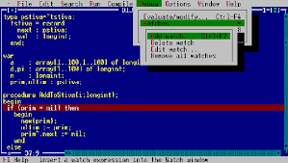
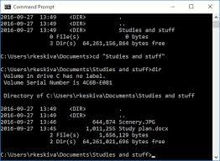
Character User Interface
A command-line interface (CLI) processes commands to a computer program in the form of lines of text
The program which handles the interface is called a command-line interpreter or command-line processor
The computer displays a prompt, the user keys in the command and presses enter or return
One of the CUI's uses is that it provides an easy way to implement programming
MS-DOS and the Windows Command Prompt and Linux OS

Slide 30
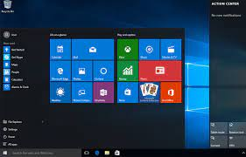
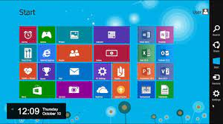
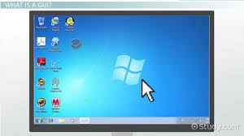
Graphical User Interface
A computer program that enables a person to communicate with a computer through the use of symbols, visual metaphors, and pointing devices
Ivan Sutherland developed Sketchpad in 1963, widely held as the first graphical computer-aided design program. It used a light pen to create and manipulate objects in engineering drawings in real-time with coordinated graphics
GUI are usually performed through direct manipulation of the graphical elements
GUIs were a hot topic in the early 1980s. The Apple Lisa was released in 1983, and various windowing systems existed for DOS operating systems (including PC GEM and PC/GEOS).

Slide 31
Assignment
What is Operating System and explain its functions.
Explain all types if Operating System(User Interface, Processing Method and mode of user) with advantage and disadvantage
Difference between GUI and CLI
Short Notes :
Buffering
Spooling

Slide 32

Windows OS
Microsoft Windows, commonly referred to as Windows, is a group of several proprietary graphical operating system families, all of which are developed and marketed by Microsoft.
Microsoft introduced an operating environment named Windows on November 20, 1985, as a graphical operating system shell for MS-DOS in response to the growing interest in graphical user interfaces (GUIs).
As of October 2021, the most recent version of Windows for PCs and tablets is Windows 11, version 21H2

Slide 33
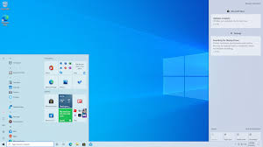
Features of Windows Operating System
GUI interface is easy to operate and user friendly
Have more icons, image, graphics, buttons etc
Pointing devices used by mouse or joystick help to locate faster
All commands can be executed by clicking or double clicking
Support Multimedia and animation
Capable of multitasking, multimedia and multiuser systems

Slide 34
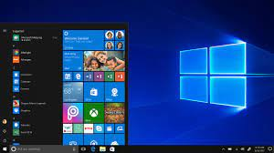
Some Basic elements of GUI in Windows
A pointer that occur as a small angled arrow and you move it to select object on your display screen is the pointer and basic component of GUI.
A device from which you pointing the objects and which enables you to select specific and required object on the screen such as mouse or trackball are the pointing devices.
Small pictures to represent any file or document are the icons which is also one of the important component of GUI. You can represent the real objects using icons that are responsive.
The area on your computer screen where all the icons group together is referred to as desktop because icons represent real objects.
Window is also important and basic component of GUI in which a single screen is divided into different areas and each window running different program. You can change the size of your window by maximizing and minimizing it.
Menus are basically a list of items from them you can choose according to your requirement and most GUI let you to execute commands by selecting choice from the menus.

Slide 35
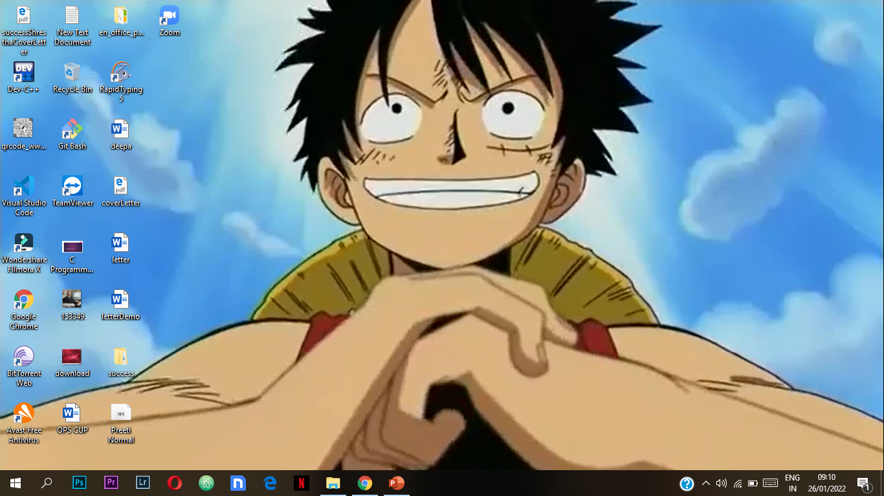
Desktop
Shortcut Apps
Whenever we boot our computer we go through login user and once we logged into our user then we get a view of desktop
A desktop is a computer display area that represents the kinds of objects one might find on top of a physical desk, including documents, project folder, applications or other system software
Basically its home screen or main screen through we can interact with other features
We can see taskbar, start button and notification bar as well
Images
Start Menu
Notification Bar
Taskbar

Slide 36
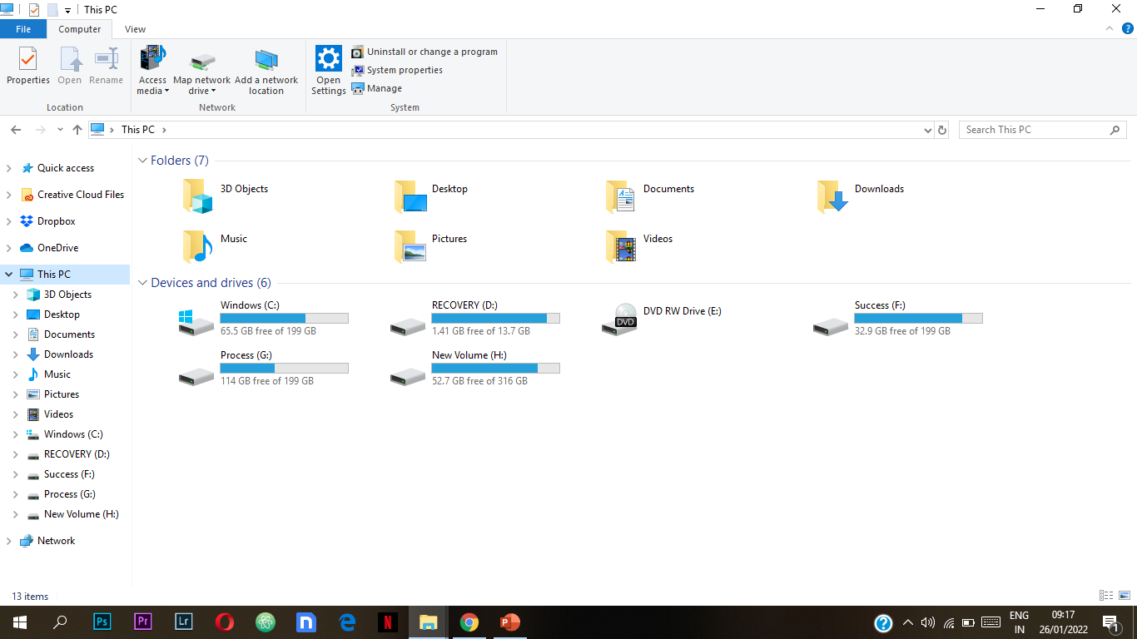
Working with control
Close
Title Bar
Minimize
Quick Access Toolbar
Address Bar
Maximize

Slide 37
Working and its control
Quick access toolbar (The Quick Access Toolbar is located to the right . It contains commands that are used most often, for example Redo, Undo and Save. )
Title Bar (Shows windows name and displayed on top)
Control Buttons( Located at the top right corner of all windows)
Minimize : Temporarily Hides the window
Maximize : Makes windows fit to screen or make small according to necessity
Close : End or close the window
Menu bar ( Give a menu system which give access to all available commands)
Address bar( A place where we can get more access various parts of system)
Scroll Bars (allow us to view information which are outside of window)
Task panes (Displayed sometimes and help us help to look what is going on background)

Slide 38
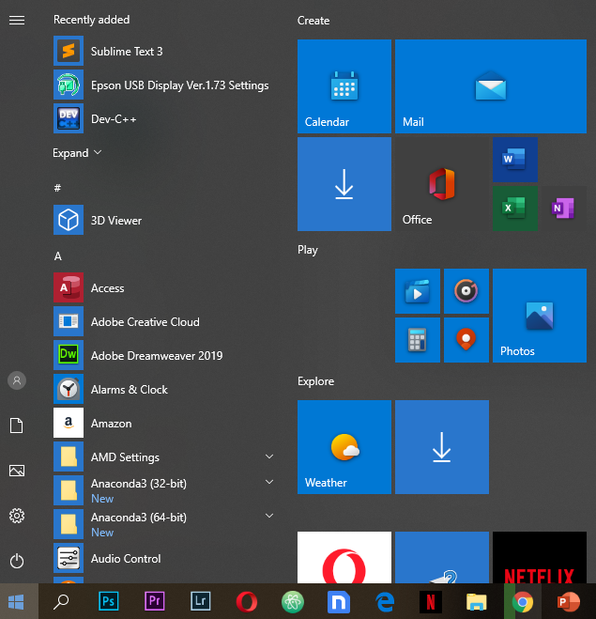
Start Menu
The Microsoft Windows Start menu is the primary location in Windows to locate your installed programs and find any files or folder
For versions of Microsoft Windows supporting the Start menu, it's found by click Start and is shown in the bottom left portion of the screen by default

Slide 39
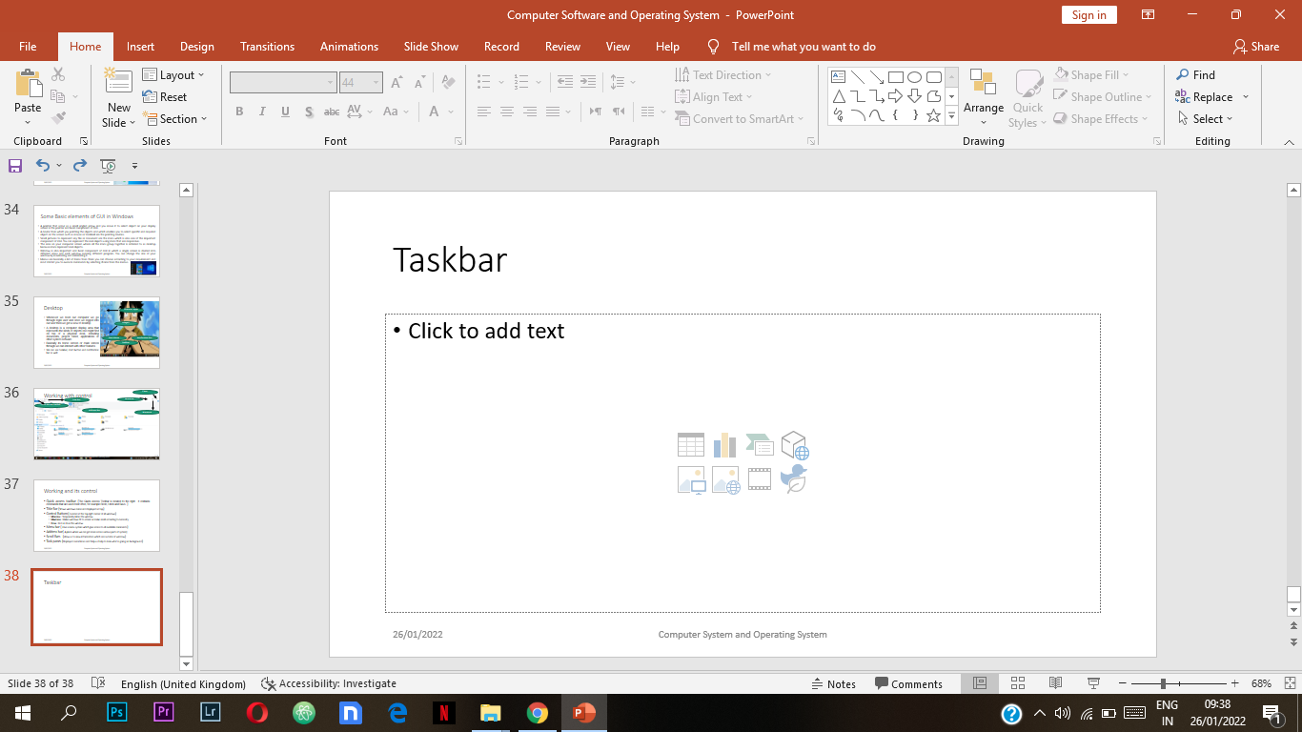
Taskbar
The taskbar is the access point for programs displayed on the desktop, even if the program is minimized
Users can view the open primary windows and certain secondary windows on the desktop, and can quickly switch between them
Search Box
Running Apps
Notification
Start Menu
Quick Lunch Apps

Slide 40

Notification Bar
Date and Time
Internet
Battery Status
Back Ground Process
Messages
Show Desktop
Volume

Slide 41
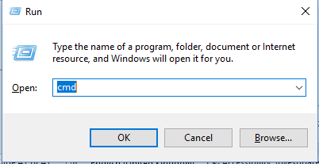
Windows Run
The Windows Run box is a feature first introduced in Microsoft Windows 95 and included in all later versions of Window
To access it, use the keyboard shortcut Windows key + R .
The Run command on an operating system such as Microsoft Windows and Unix-like systems is used to directly open an application or document whose path is known
It's kind of a shortcut to access windows services & applications

Slide 42
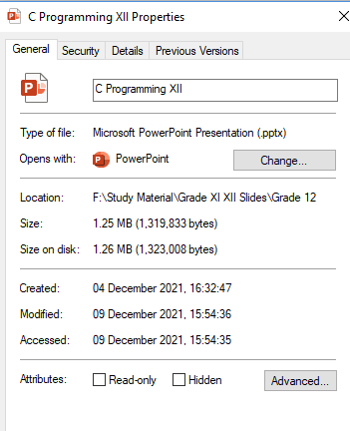
Files
File is a collection or group of interlinked data and information
Files have extensions to identify their type but folders do not have extensions
File extension cab be .cpp .jpg .xml .java etcs

Slide 43
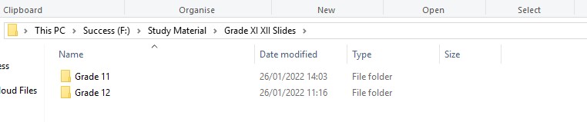
Folder
Folder is a container used to store files and subfolders
F:\Study Material\Grade XI XII Slides
We need to uniquely give name to folders
Folders are allowed to be shared on the network

Slide 44
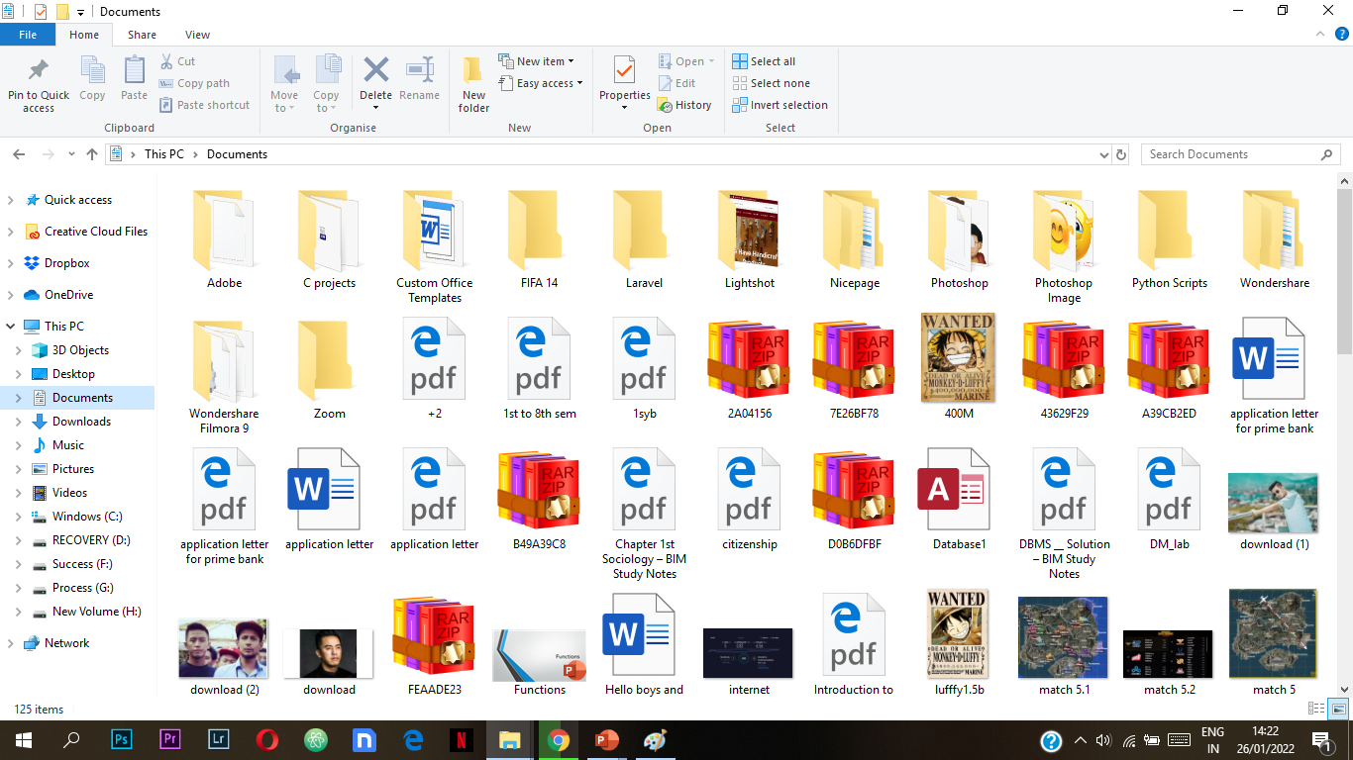
My Document
It’s a default folder where our documents are saved
We store some personal files documents and other files
If we have to change OS then this all files will be delete because its all stored on C Drive

Slide 45
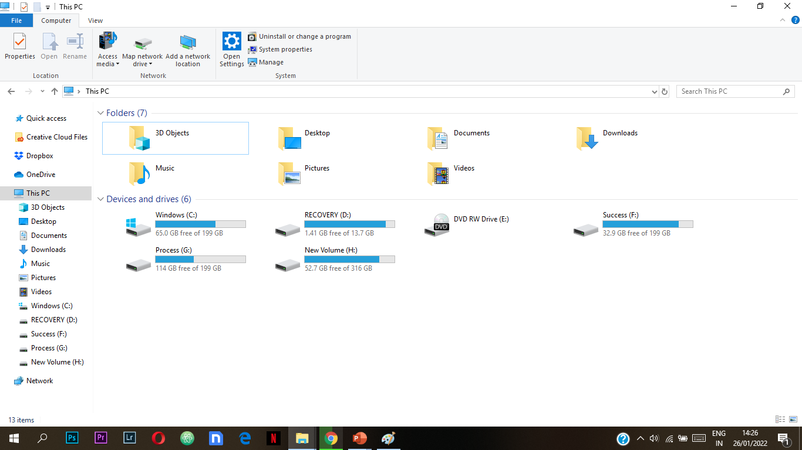
My Computer
My Computer is seen on the Microsoft Windows computers which allows the user to access the local drives, such as the local disk, also known as the C: Drive
My computer also lets the user access My Documents and other files
My Computer folder is a gateway to all the data stored on the computer, attached devices, and the network -- as well as a shortcut to most of your system information

Slide 46
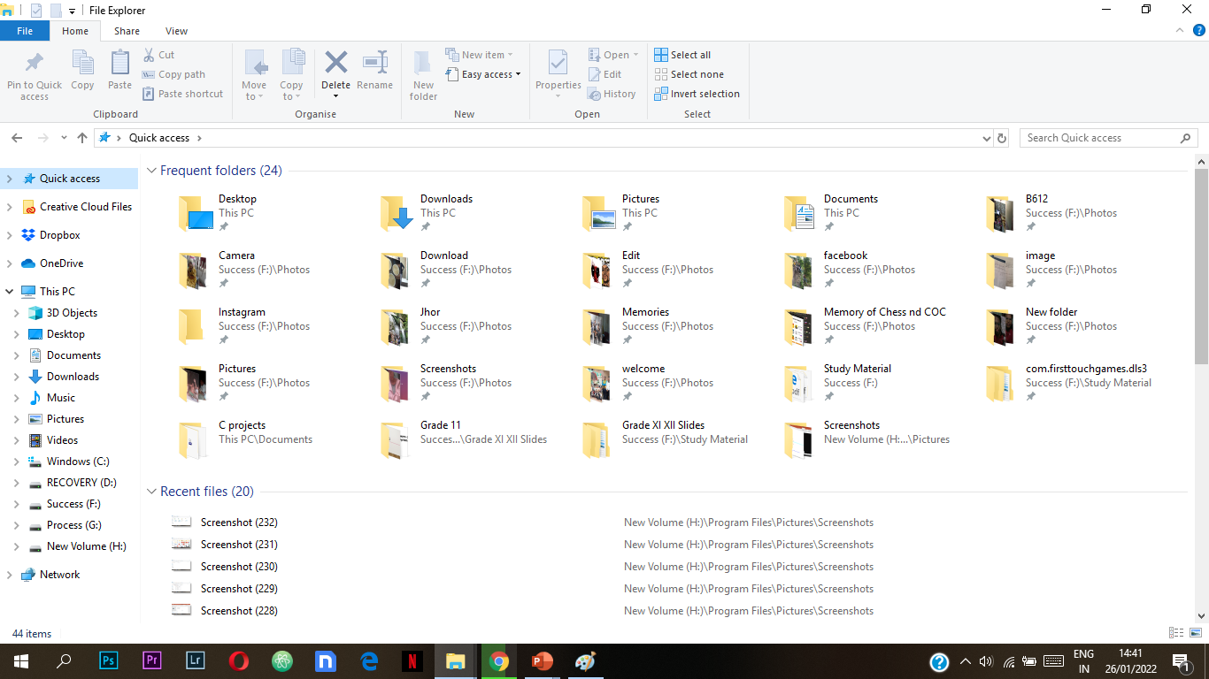
File Explorer
File Explorer
Ribbon
Frequently Used Folder
Navigation Pane
Recent Files

Slide 47


File Explorer
At menu bar we get many options like copy paste or hide the file/folder
We can change our layouts
By the file explorer we can get into any destination where our files are located and we can do various actions

Slide 48


Creating Deleting or Renaming Folder

Slide 49
Move
Copy
Select the file or folder
Select Home tab and choose “Move to” tab
Choose the location using navigation
Click on Move Button
Or,
Select the file or Folder
Right click on mouse and select Move
Go to folder where we want to paste
Right click on mouse and select paste
Select the file or folder
Select Home tab and choose “Copy to” tab
Choose the location using navigation
Click on Copy Button
Or,
Select the file or Folder
Right click on mouse and select Copy
Go to folder where we want to paste
Right click on mouse and select paste

Slide 50
Hiding
Recycle Bin
Select the file or folder
Select View tab and choose “Hide” tab
Your selected file and folder gets hidden
Place where all delete files or folder are stored
Unless we don’t clear the recycle bin all files and data are stored in recycle bin
WE can restore files by selecting file which we want to restore and right click you can select restore
Or we can simply delete all for delete option in home tab

Slide 51

Customize your Desktop
We can change our desktop background by different images (single or multiple)
Select Start
Settings
Personalization
Background.
In the list, select Picture, Solid color, or Slideshow.
Select image

Slide 52

Customizing Start
Select Start
Settings
Personalization
Background.
In the list, select Picture, Solid color, or Slideshow.
Select image

Slide 53
Managing Passwords

Slide 54
Control Panel
The Control Panel is a component of Microsoft Windows that provides the ability to view and change system settings
It consists of a set of applets that include adding or removing hardware and software, controlling user accounts, changing accessibility options, and accessing networking settings
Add fonts and dealing with date and time changes
Adding or removing programs

Slide 55


Slide 56
Accessories
Calculator
Notepad
WordPad
Paint
Magnifier
On screen Keyboard

Slide 57

Open Source Operating System
An Open-source Operating System is the Operating
System in which source code is visible publicly and editable
Anyone can inspect, modify, and enhance the source code
Closed Operating Systems are built with numerous codes and complex programming and that is called source code
In open source operating system, programmers have access to a computer program's source code can improve that program by adding features to it or fixing parts that don't always work correctly
The one who create any open source operating system then developer need to provide code as copyleft licence
By copyleft licence any can view modify change any line of code as per we need and we need to provide its source code so next one take copyleft licence

Slide 58

Open Source Operating System
Advantage
Disadvantage
Open source software is free to use
The users do not need to worry about monitoring and tracking
It does not pose any restrictions on the number of times it can be installed
The number of people involve in maintaining an open source software is more in hundreds and thousands.
Anyone can write modify or view codes and made as per their choice
Not all the open source applications are easy to use
someone misuses the code for their own benefits
Some applications cannot support both open source software and proprietary software
If you face any problems in the implementation process, a third party support may be needed which could charge additionally
Finding required drivers for hardware components is not an easy task

Slide 59

UNIX
UNIX is a family of multitasking, multiuser computer operating systems that derive from the original AT&T Unix, whose development started in 1969 at the Bell Labs research center by Ken Thompson, Dennis Ritchie, and others
The suite of programs which make the computer work. It is a stable, multi-user, multi-tasking system for servers, desktops and laptops.
Best of networking capability.
It allows many users to share a powerful machine and all the available resources, each user running their own processes simultaneously
Linux, Mac OS X, Android, iOS, Chrome OS, Orbis OS

Slide 60


Linux
Linux is a family of open-source Unix-like operating systems based on the Linux kernel
operating system kernel first released on September 17, 1991, by Linus Torvalds
Linux is a free, open source operating system, released under the GNU General Public License (GPL)
It is flexible, open source platform, portability and command line interface and compatibility

Slide 61
Every OS has component parts, and the Linux OS also has the following components parts:
Bootloader. (Booting is the process of starting of computer .)
OS Kernel. (access to memory and any peripheral devices. It is the “lowest” level at which your operating system works.)
Background services.[Daemons] (these small applications act as servants in the background, ensuring that key functions such as scheduling, printing and multimedia function correctly.)
OS Shell. (You need to be able to tell our operating system what to do, and this is the goal of the shell. Also known as the command line, it is a facility which lets you instruct your OS using text)
Graphics server. (renders images and shapes on your computer monitor. Linux uses a graphical server called “X” or “X-server”)
Desktop environment.( You can’t interact with the graphical server directly. Instead you need software that can drive the server. A desktop environment is usually bundled with a number of applications including file and web browsers plus a couple of games.)
Applications( We do have bunch of software but on limited compared to windows and mac OS Linux distros on app stores which help you find and install apps, for example Ubuntu Software which comes with Ubuntu)

Slide 62

Features of LINUS / UNIX
Multitasking and multiuser.
Programming interface.
Built-in networking (TCP/IP is standard)
The System hides the machine architecture from the user, making it easier to write applications that can run on micros, mins, and mainframes.
It allows for easy maintenance and efficient implementation

Slide 63

Linux Distributor
is an operating system made from a software collection that is based upon the Linux kernel and, often, a package management system
The software packages are available online in so-called repositories, which are storage locations usually distributed around the world.
Currently, more than 600 Linux distributions are actively maintained. There are commercially backed distributions, such as Fedora (Red Hat), openSUSE (SUSE) and Ubuntu (Canonical Ltd.), and entirely community-driven distributions, such as Debian, Slackware, Gentoo and Arch Linux.

Slide 64

Some Distributor
Debian(Earliest Version of Linux )
Fedora (Fedora Workstation is a polished, easy to use operating system for laptop and desktop computers, with a complete set of tools for developers and makers of all kind)
openSUSE (openSUSE is a project that serves to promote the use of free and open-source software. )
Arch Linux (Arch Linux is a Linux distribution created for computers with x86-64 processors)
Red Hat (Red Hat provides storage, operating system platforms, middleware, applications, management products, and support, training, and consulting services. Red Hat creates, maintains, and contributes to many free software projects.)

Slide 65

Mobile Operating System
A mobile operating system (OS) is software that allows smartphones, tablet PCs (personal computers) and other devices to run applications and programs
Mobile operating systems also manage cellular and wireless network connectivity, as well as phone access.
Mobile OS has built on what the computer OS has accomplished

Slide 66
Types of Mobile OS
Android OS
Blackberry OS
Apple iOS
Bada
Symbian OS
Harmony OS
Palm OS
WebOS
Windows Mobile Operating System

