Slide 1
Object oriented programming (OOP)
Chapter : 5

Slide 2
Programming Paradigm
Programming paradigms are a way to classify programming languages based on their features.
Some paradigms are concerned mainly with implications for the execution model of the language, such as allowing side effects, or whether the sequence of operations is defined by the execution mode
Some of major programming paradigm
  Procedural Oriented Programming
  Structure Programming
  Object Oriented Programming

Slide 3
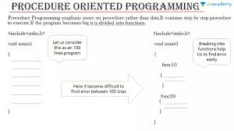
Procedural Oriented Programming
Procedural Programming is the use of code in a step-wise procedure to develop applications
Follows a step-by-step approach to break down a task into a collection of variables and routines (or subroutines) through a sequence of instructions
Code will be processed logically and in a structured order
Procedures will be created to allow a series of steps to be followed.
Example: COBAL, FORTAN, C, JAVA etc

Slide 4
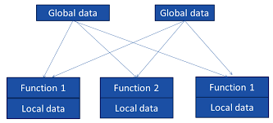
Characteristics of Procedural Oriented
It emphasis on algorithm (doing this ).
Large programs are divided into smaller programs known as functions.
Function can communicate by global variable.
Data move freely from one function to another function.
Functions change the value of data at any time from any place. (Functions transform data from one form to another.)
It uses top-down programming approach.

Slide 5
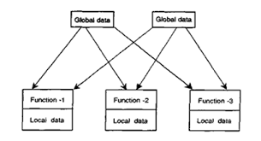
Limitation of Procedural Language
Procedural programming mainly focuses on procedures or functions. Less attention is given to the data.
The data and functions are separate from each other.
Global data is freely moving and is shared among various functions. Thus, it becomes difficult for programmers to identify and fix issues in a program that originate due to incorrect data handling.
Changes in data types need to be carried out manually all over the program and in the functions using the same data type.
Limited and difficult code reusability.
It does not model real-world entities (e.g., car, table, bank account, loan) very well where we as a human being, perceive everything as an object.
The procedural programming approach does not work well for large and complex systems.

Slide 6
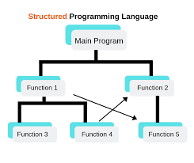
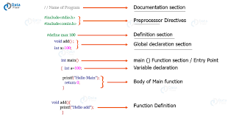
Structure Programming
Is a programming paradigm that facilitates the creation of programs with readable code and reusable components
Its an subset of procedural oriented language
All modern programming languages support structured programming, but the mechanisms of support, like the syntax of the programming languages, varies
Structured programming encourages dividing an application program into a hierarchy of modules or autonomous elements, which may, in turn, contain other such elements
It also follow top-down approach
Have three categories ( Sequence, Control Structure and Iteration )
We can use both local or global variables

Slide 7
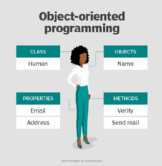
Object Oriented Programming (OOP)
Object-oriented programming (OOP) is a computer programming model that organizes software design around data, or objects, rather than functions and logic
An object can be defined as a data field that has unique attributes and behaviour
Three major principles of OOPs encapsulation, inheritance and polymorphism
We make class and we create its object and work with data rather than logics
Class is a user-defined datatype that has its own data members and member functions
Object is an instance of class by which we can access the data members and member functions of the class
Colour
Flag
Hair
Body
Beard
Nepal
Portugal
Japan

Slide 8
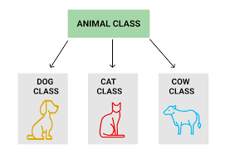
Principles of OOP
Objects and Class
Encapsulation and Data Abstraction
Inheritance
Polymorphism

Slide 9
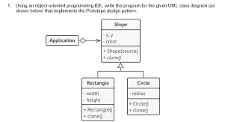
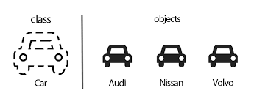
Object and Class
Class can be defined as design(template or blue print) that describes state and behaviour that object
Object have state and behaviour (Dog state[colour, name] and behaviour like barking eating and other…..
We normally make a class name dog and give them some behaviour and we will create an object of that dog class giving a separate name and we can take all behaviour form that dog class
An object is instance of any class

Slide 10
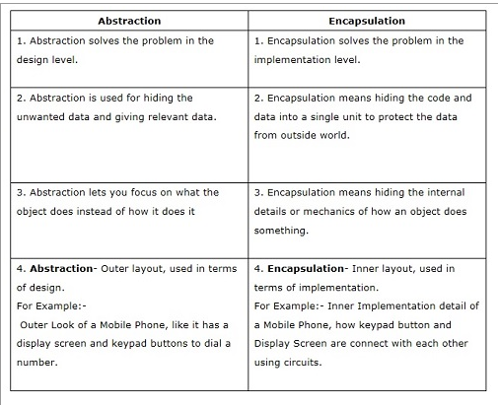
Encapsulation and Data abstraction
Encapsulation is defined as the wrapping up of data under a single unit (It is the mechanism that binds together code and the data it manipulates)
Data abstraction refers to providing only essential information about the data to the outside world, hiding the background details or implementation.

Slide 11
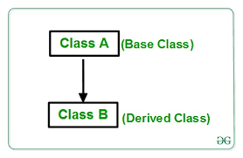
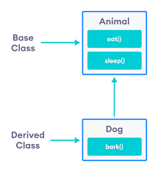
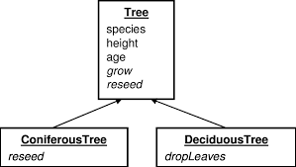
Inheritance
Inheritance is the procedure in which one class inherits the attributes and methods of another class
The class whose properties and methods are inherited is known as the Parent
We can reuse the fields and methods of the existing class
Inheritance is the process of creating a new Class, called the Derived Class , from the existing class, called the Base Class

Slide 12
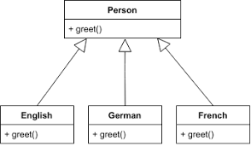
Polymorphism
Polymorphism is one of the core concepts of object-oriented programming (OOP) and describes situations in which something occurs in several different forms
Describes the concept that you can access objects of different types through the same interface
Allows us to perform a single action in different ways
Polymorphism allows you to define one interface and have multiple implementations

Slide 13
Advantage of OOP
A real-world idea can be demonstrated, as everything in OOP is treated as an object.
As we use the concept of encapsulation, programs are easier to test and maintain.
Faster development of code is done as we develop classes parallel instead of sequentially.
OOP provides greater security due to data abstraction. The outside world cannot access the hidden data.
Reusability can be achieved by using classes that have been already written.

Slide 14
Disadvantage of OOP
Designing a program with an OOP concept can be tricky.
A programmer needs to plan beforehand for developing a program in OOP.
The size of programs developed with OOP is bigger than those developed with a procedural approach.
Since OOP programs are larger in size, the execution time for these programs is also more.

Slide 15
Structured Programming | Object-Oriented Programming
It is a subset of procedural programming. | It relies on concept of objects that contain data and code.
Programs are divided into small programs or functions. | Programs are divided into objects or entities.
It is all about facilitating creation of programs with readable code and reusable components. | It is all about creating objects that usually contain both functions and data.
Its main aim is to improve and increase quality, clarity, and development time of computer program. | Its main aim is to improve and increase both quality and productivity of system analysis and design.
It simply focuses on functions and processes that usually work on data. | It simply focuses on representing both structure and behavior of information system into tiny or small modules that generally combines data and process both.
It is a method of organizing, managing and coding programs that can give or provide much easier modification and understanding. | It is a method in which set of objects can vary dynamically and can execute just by acting and reading to each other.
In this, methods are written globally and code lines are processed one by one i.e., Run sequentially. | In this, method works dynamically, make calls as per need of code for certain time.
It generally follows “Top-Down Approach”. | It generally follows “Bottom-Up Approach”.
It provides less flexibility and abstraction as compared to object-oriented programming. | It provides more flexibility and abstraction as compared to structured programming.
It is more difficult to modify structured program and reuse code as compared to object-oriented programs. | It is less difficult to modify object-oriented programs and reuse code as compared to structured programs.
It gives more importance of code. | It gives more importance to data.

Slide 16
Assignment
Difference between
  Structure and OOP
  OOP and Procedural
Explain principles of OOP
Write Short notes on
  Structure Oriented Programming
  OOP
  Procedural Programming

