Slide 1
Programming Concept and Logics
Chapter 5

Slide 2
Introduction
Programming logic is a set of principles that delineates how elements should be arranged so a computer can perform specific tasks
Practice writing a lot of code
Check solutions by other people
Use a pen and paper to work out solutions
Keep learning new things
Be consistent
Face problems head-on
Don't lose motivation

Slide 3
Programming Language
Used to write instructions for the computer
Basically these all are communication process between programmer and machine
Programmer express data processing in a symbolic manner without regard to machine-specific details
Types of Programming Language
Low Level
High Level

Slide 4
Low Level Preprograming Language
A low-level programming language is a programming language that provides little or no abstraction from a computer's instruction set architecture
Commands or functions in the language map that are structurally similar to processor's instructions
This refers to either machine code or assembly language

Slide 5
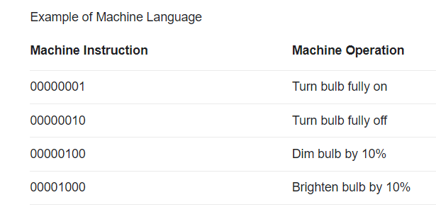
Machine Level Language
The machine-level language is a language that consists of a set of instructions that are in the binary form 0 or 1
Computers can understand only machine instructions, which are in binary digits, i.e., 0 and 1, so the instructions given to the computer can be only in binary codes
These language are directly understood by CPU
Simply O means Off or False and 1 means ON or True

Slide 6
Advantage and Disadvantage of Machine Level Language
Advantage | Disadvantage
No need to translator High Speed Machine Efficiency | Machine Dependent Complex To code Hard to debug or Trouble shoot User efficiency

Slide 7
Assembly Level Language
An assembly language is a type of low-level programming language that is intended to communicate directly with a computer's hardware
Assembly languages are designed to be readable by humans
Assembly language statement is a line of text that translates into a single machine instruction
Mnemonics are used instead of 0 & 1
Mnemonics are alphanumeric symbolic codes and English abbreviations (ADD, SUB ,CLA, LAL, KTM)

Slide 8
Advantage and Disadvantage of Assembly Language
Advantage | Disadvantage
Mnemonics Helps to understand the code Less error due to English like structure Efficiency More Control Over Hardware Easy to debug as compared to Machine Level Language | Machine Dependent Harder to learn Slow Development Time Slower execution compared to machine language

Slide 9
High Level Language
High-level languages allow programmers to write instructions in a language that is easier to understand than low-level languages
Translators are needed to translate programs written in high-level languages into the machine code that a computer understands
designed to simplify computer programming
Is user-oriented in that it has been designed to make it straightforward for a programmer to convert an algorithm into program code
They are closer to human languages and further from machine languages
Example : C ,C++, Java, Python

Slide 10
Advantage and Disadvantage of High Level Language
Advantage | Disadvantage
Readability Machine Independent Easy Debugging Easier to maintain Low Development Cycle Easy Documentation | Poor Control over Hardware Need Extra Translator Slow Run time Memory allocation Need to remember all syntax

Slide 11
Procedure Oriented Language (3GL)
A procedural language is a type of computer programming language that specifies a series of well-structured steps and procedures within its programming context to compose a program
It contains a systematic order of statements, functions and commands to complete a computational task or program
The procedural language segregates a program within variables, functions, statements and conditional operators
Features
Similar to English and easy to use
Easy to write and modify due to English structure
Less time in Development
Standardized and Machine Independent

Slide 12
Problem Oriented Language
A computer language designed to handle a particular class of problem.
These language uses database to store and retrieve data
Example MYSQL SQL etc
Features
Need to know machine characteristics
Easy to find bug and debug
Coding is faster and easier
Use of standard math symbol
Machine Independent

Slide 13
Natural Language
Natural language processing helps computers communicate with humans in their own language and scales other language-related task
It makes it possible for computers to read text, hear speech, interpret it, measure sentiment and determine which parts are important
Example LISP, PROLOG etc

Slide 14
Language Processor Translator
Assembler
Compiler
Interpreter

Slide 15
Syntax and Semantics
Syntax of a programming language is a collection of rules to specify the structure or form of code
Semantics refers to the interpretation of the code or the associated meaning of the symbols, characters or any part of a program (ab+c, "ab"+"c", mult(5,4) )

Slide 16
Programming Error and its types
Syntax Error
Runtime Error
Logical Error

Slide 17
Syntax Error
Syntax errors are mistakes in using the language
Syntax tells you how a sentence is worded and structured, which can easily be misconstrued
Syntax errors are missing a comma or a quotation mark, or misspelling a word

Slide 18
Run time Error
A problem that is encountered when a program is being executed
Runtime errors can occur in software environments for many different reasons
Examples
IO errors
Division by zero errors
File not created
Memory Space allocation

Slide 19
Logical Error
Logic errors occur when there is a fault in the logic or structure of the problem
Logic errors do not usually cause a program to crash but produce unexpected results.

Slide 20
Control Structure
Sequence
Selection
Iteration

Slide 21
Program Design tools
Program Design tools are the tools used to develop a program
Popular tools and technique used to represent the programs are Algorithm, Flowchart, and Pseudocode

Slide 22
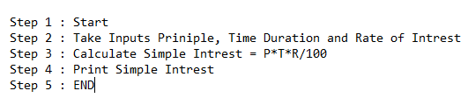
Algorithm
An algorithm is simply a set of steps used to complete a specific task.
Algorithm is a procedure or formula used for solving a problem
It is based on conducting a sequence of specified actions in which these actions describe how to do something, and your computer will do it exactly that way every time
They're the building blocks for programming, and they allow things like computers, smartphones, and websites to function and make decision

Slide 23
Properties of Algorithm
Input/Output
Definiteness (Each step in algorithm need to be simple clear and unambiguous)
Finiteness (It need to be finished in finite steps)
Correctness (Output need to be correct as each set of inputs)
Effectiveness (Need to be complete in finite time)

Slide 24
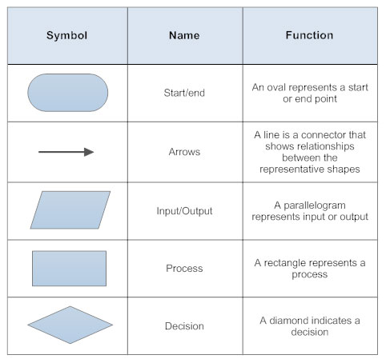
Flow Chart
A flowchart is a picture of the separate steps of a process in sequential order
It is a generic tool that can be adapted for a wide variety of purposes, and can be used to describe various processes, such as a manufacturing process, an administrative or service process, or a project plan
Flowcharts use special shapes to represent different types of actions or steps in a process

Slide 25
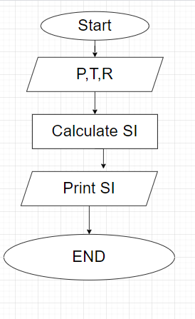
Programmer use flowchart for:
System Flowchart
System flowcharts are a way of displaying how data flows in a system and how decisions are made to control event
They are connected together to show what happens to data and where it goes
Program Flowchart
They are connected together to show what happens to data and where it goes.
It allows the user to explain the process quickly as they collaborate with others
hey give commands like start, process, decision, and end, and these symbols are the crucial part of the programming flowcharts

Slide 26
Use of Flowchart
Analytical Tools
Troubleshooting Guides
Process Documentation
Instant Communication
Problem-Solving
Effective Analysis

Slide 27
Rules to make flowchart
Always format your flow from left to right or top to bottom.
Run your return lines under your flowchart, making sure that they don’t overlap.
Maintain consistent spacing between symbols.
Use the correct symbol for each step

Slide 28
Advantage of Flowchart
It is a convenient method of communication.
It indicates very clearly just what is being done, where a program has logical complexities.
A key to correct programming.
It is an important tool for planning and designing a new system.
It clearly indicates the role-played at each level.
It saves the inconveniences in future and serves the purpose of documentation for a system.
It provides an overview of the system and also demonstrates the relationship between various steps.
Facilitates troubleshooting.
It promotes logical accuracy.

Slide 29
Disadvantage of Flowchart
The flowchart is a waste of time and slows down the process of software development.
The flowchart is quite costly to produce and difficult to use and manage.
Flowcharts are not meant for man to computer communication.
Sometimes the Complex logic of the program logic is quite complicated to draw out on by using different defined shapes. In that case, flowchart becomes complex and clumsy. This will become a pain for the user, resulting in a waste of time and money trying to correct the problem
If you need to modify or alternate the process then it will be very hard to do in the flowchart. Because either you will have to erase the end of the flowchart or start.

Slide 30
Structure English (Pseudo Code)
Pseudocode is an artificial and informal language that helps programmers develop algorithms
Pseudocode is a "text-based" detail (algorithmic) design tool
An informal way of programming description that does not require any strict programming language syntax or underlying technology considerations
Pseudocode is not an actual programming language. So it cannot be compiled into an executable program

Slide 31
Example of Pseudo Code
if “Assignment is done”
print “You will get good internal Marks"
Else if “ You get good grades”
Print “ It may consider but you get few grades”
else
print “M completely sorry I do no mercy"
if “value of i is less than 10”
print “Print i"
else
print “YOHOHOHO"

Slide 32
Binary Code
When numbers, letters or words are represented by a specific group of symbols, it is said that the number, letter or word is being encoded
Digital data is represented, stored and transmitted as group of binary bits
This group is also called as binary code
Various ways to represent data in computer are
Absolute Binary
BCD( Binary Coded Decimals)
ASCII ( American Standard Code of Information Interchange)
EBCDIC
Unicode

Slide 33
Absolute Binary
We represent number in absolute( exact) its binary form
7 ie 111 or 31 11111
We convert number in base 2

Slide 34
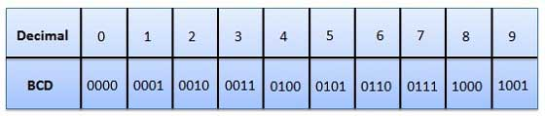
BCD (Binary Coded Decimal)
In this code each decimal digit is represented by a 4-bit binary number
In the BCD, with four bits we can represent sixteen numbers (0000 to 1111)
But in BCD code only first ten of these are used (0000 to 1001). The remaining six code combinations i.e. 1010 to 1111 are invalid in BCD

Slide 35
ASCII (American Standard Code for Information Interchange)
Is a character encoding standard for electronic communication
Represent text in computers, telecommunications equipment, and other devices
There are 128 standard ASCII characters, numbered from 0 to 127 (0000000 TO 1111111)
ASCII value use 7 bit to represent its value

Slide 36
EBCDIC
Extended Binary Coded Decimal Interchange Code
Data-encoding system, developed by IBM and used mostly on its computers, that uses a unique eight-bit binary code for each number and alphabetic character as well as punctuation marks and accented letters and nonalphabetic characters
This code is used in text files of S/390 servers and OS/390 operating systems of IBM

Slide 37
Unicode
Is an information technology standard for the consistent encoding, representation, and handling of text expressed in most of the world's writing system
A character code that defines every character in most of the speaking languages in the world
Unicode supports more than a million code points, which are written with a "U" followed by a plus sign and the number in hex
The word "Hello" is written U+0048 U+0065 U+006C U+006C U+006F (

Slide 38
Assignment
What is programming language with its types including it merits and demerits
Explain High level language with its types
Short note
ASCII
BCD
Flowchart
Pseudo Code
What is algorithm and Write a algorithm, Flowchart to find sum of 1 to 100 numbers
Write an algorithm flowchart and pseudo code to find out multiplication table
Write a flowchart and pseudo code to check any number is even or odd

