Slide 1
Boolean Algebra
Chapter 2

Slide 2
Introduction
Boolean algebra is a division of mathematics that deals with operations on logical values and incorporates binary variables
Boolean algebra was introduced by George Boole in his first book The Mathematical Analysis of Logic(1847), and set forth more fully in his An Investigation of the Laws of Thought (1854)
Boolean Algebra is used for Digital Circuits and Computer Hardware class
Boolean algebra is used to design and simplify circuits of electronic devices

Slide 3
Difference Between Boolean and ordinary algebra
Boolean Algebra | Ordinary Algebra
They take two values, i.e. 0 and 1 | The letter symbols take any number of values
They have a logical significance | The values assigned to a variable have a numerical significance
” . ” means an AND operation and ” + ” means OR operation | ” . ” and ” + ” are the signs of multiplication and addition #

Slide 4
Boolean Expression
A logical statement that results in a Boolean value, either be True or False
Sometimes, synonyms are used to express the statement such as ‘Yes’ for ‘True’ and ‘No’ for ‘False’. Also, 1 and 0 are used for digital circuits for True and False, respectively
Use logical operators, i.e., AND, OR and NOT

Slide 5
Operator Operation And Operands
Operator | Symbol | Operation | Operands
Addition | + | 3+2 = 5 | 3 , 2
Subtraction | - | 3-2 = 1 | 3 , 2
Multiplication | * | 3 * 2 = 6 | 3 , 2
Division | / | 3 / 2 = 1.5 | 3 , 2
Relation | <,>,<=,>= | 3 > 2 True 3 < 2 False | 3 , 2
Logical | AND, OR, NOT

Slide 6
Truth Table
A truth table is a breakdown of a logic function by listing all possible values the function can attain (Results )
A truth table is a mathematical table used in logic
Used to determine the truth or falsity of propositional statements by listing all possible outcomes of the truth-values for the included propositions

Slide 7
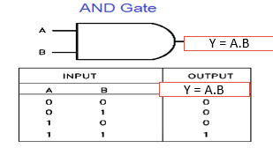
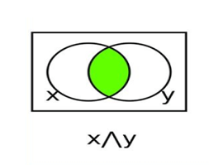
And Gate
The AND gate is a basic digital logic gate that implements logical conjunction (∧) from mathematical logic
It behaves according to the truth table above
A HIGH output (1) results only if all the inputs to the AND gate are HIGH (1).
X . Y = Output

Slide 8
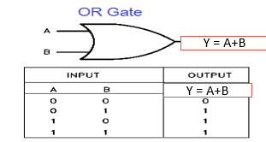
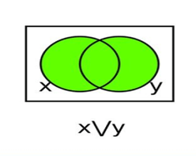
OR Gate
OR gate is a digital logic gate that gives an output of 1 when any of its inputs are 1, otherwise 0
An OR gate performs like two switches in parallel supplying a light, so that when either of the switches is closed the light is on
X + Y = F

Slide 9
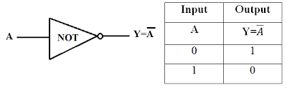
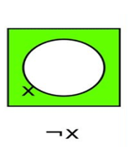
NOT Gate
A NOT gate uses just one input to generate one output
A NOT gate inverts the input - the output is 1 (TRUE) if the input is 0 (FALSE), and the output is 0 (FALSE) if the input is 1 (TRUE)

Slide 10
Universal Gate
A universal gate is a gate which can implement any Boolean function without need to use any other gate type
They can be combined to produce any of the other gates like OR, AND, and NOT gates
The NAND and NOR gates are universal gates

Slide 11
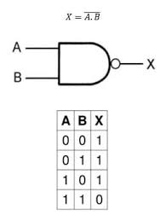
NAND Gate
NAND gate (NOT-AND) is a logic gate which produces an output which is false only if all its inputs are true
Thus its output is complement to that of an AND gate
If we pass low(0) then we get high(1) as output and vice versa
X = (A . B) ’

Slide 12
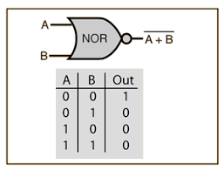
NOR
A NOR gate or a NOT OR gate is a logic gate which gives a positive output only when both inputs are negative
That can be combined to form of OR and NOT gates
If both inputs are low(0) then we get high(1) as output and vice versa
X = (A + B ) ‘

Slide 13
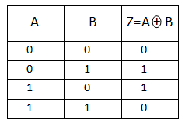
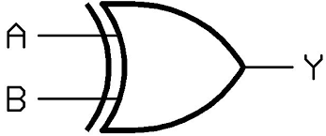
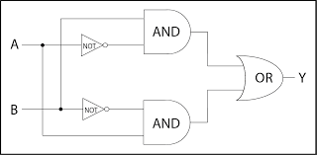
Exclusive or (XOR)
Is a logical operator which results true when either of the operands are true (one is true and the other one is false) but both are not true and both are not false.
Output is true is there is different in output, If there is same input it gives false output
Z = A’ . B + A . B’

Slide 14
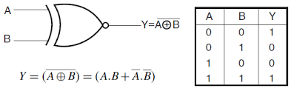
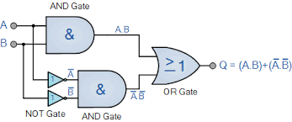
Exclusive NOR (XNOR)
The XNOR Gate stands for “exclusive NOR” referring to its architecture as a logic gate wherein a positive output is only achieved if both inputs are equal.
If we have same inputs then we get true or any of alter inputs we get false results
Y=A’.B’+A.B

Slide 15
Laws of Boolean algebra
Commutative Law
Associative Law
Distribute Law
Identity Law
Complement Law

Slide 16
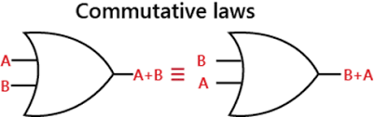
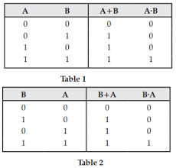
Commulative law
Commutative Law states that the interchanging of the order of operands in a Boolean equation does not change its result
OR operator → A + B = B + A. AND operator → A * B = B * A

Slide 17
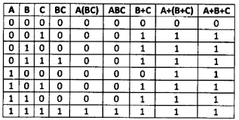
Associative law
This law allows the removal of brackets from an expression. and regrouping of the variables
A + (B + C) = (A + B) + C = A + B + C
A . (B . C) = (A . B) . C = A . B . C

Slide 18
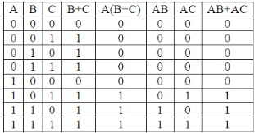
Distributive law
Multiplication of two variables and adding the result with a variable will result in the same value as multiplication of addition of the variable with individual variables
A ( B + C ) = A B + A C

Slide 19
Identity law
It has two expressions: 1 AND A
the product of 1 and any number or variable is the number or variable itself.
A.1 = A A + 0 = A
A | 0 | A+0 | 1 | A+1
0 | 0 | 0 | 1 | 1
1 | 0 | 1 | 1 | 1

Slide 20
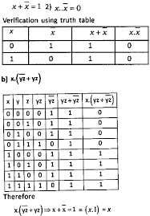
Compliment law
The complement is the inverse of a variable and is indicated by a bar over variable (overbar)

Slide 21
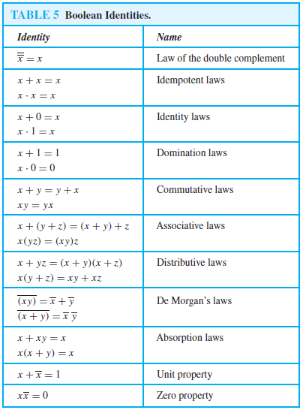
Some identities of Boolean Algebra

Slide 22
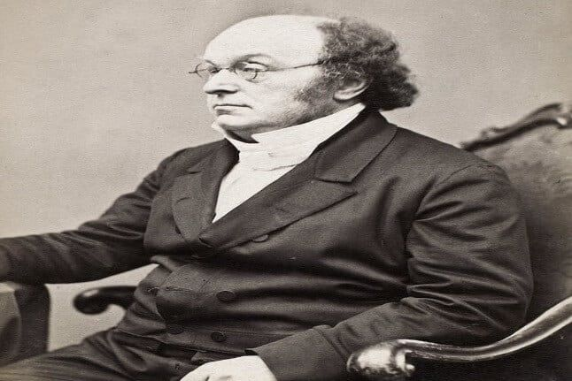
DE Morgan's theorem
The laws are named after Augustus De Morgan (1806–1871) who introduced a formal version of the laws to classical propositional logic

Slide 23
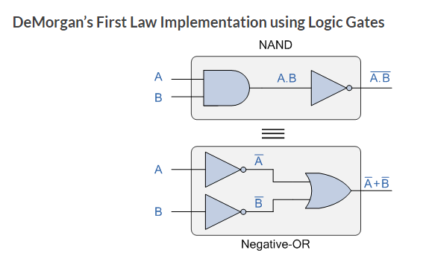
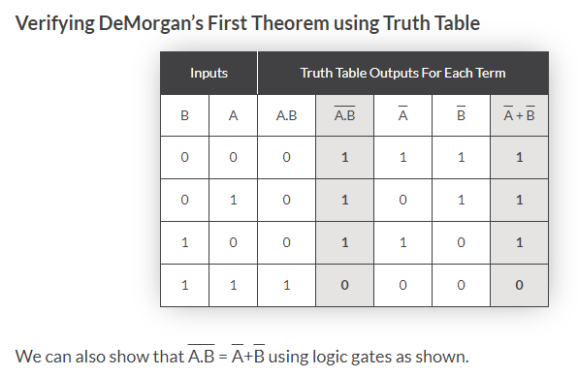
De Morgan's first law
According to De Morgan's Law, the complement of the union of two sets will be equal to the intersection of their individual complements
The complement of the intersection of two sets will be equal to the union of their individual complements
(A+B)’ = A’ . B’

Slide 24
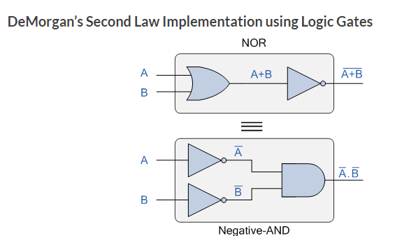
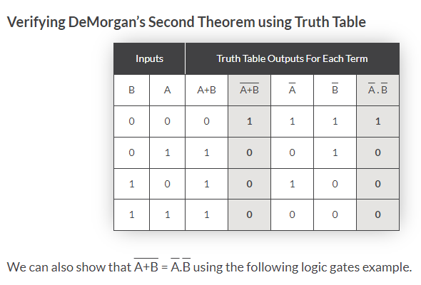
De Morgan's Second law
The second law or the Law of Intersection states that an element not in A ∩ B is not in A' or not in B’
the complement of the Intersection of two sets is the same as the Union of their complements; i.e. Not (A and B)
(A . B)’ = A’ + B’

Slide 25
References
https://www.electronics-tutorials.ws/logic/universal-gates.html
https://en.wikipedia.org/wiki/De_Morgan's_laws
https://www.javatpoint.com/laws-of-boolean-algebra
http://www.uop.edu.pk/ocontents/ELEC-DIGE-S4%20Boolean%20Algebra%20Laws%20.pdf

