Slide 1

Database Management System
Chapter 1
Success Shrestha

Slide 2


Data
Information
Facts and statistics collected together for reference or analysis
Datas can be on paper, or computer
In computer, data are stored in folders
Data can be image, text, audio or videp
Facts provided or learned about something or someone
Information is an obtained by processing data
Information can be obtained by investagation, research, study or instruction
DATA
Processing
INFORMATION

Slide 3

Database
Organized collection of structured information, or data, typically stored electronically in a computer system
Is systematic collection of data
Data in database are related data
Phone directory, Library Booklist and so on
We can filter data in database and pick chosen one

Slide 4
Database Management System (DBMS)
Is a software package designed to define, manipulate, retrieve and manage data in a database
Generally manipulates the data itself, the data format, field names, record structure and file structure
Computerized data-keeping system
There are variety of software such as MySQL, SQL, Oracle, Sqlite, MS access and so on
Three elements

Slide 5
Basic things of Database
Table
Field
Records
Object
File
Key
  Primary Keys
  Alternative Keys
  Candidate keys
  Foreign keys

Slide 6
Database Table
Database table is composed of records and fields which hold data
Data is logically organized in a row-and-column format similar to a spreadsheet
In database table similar kind of data are stored
Each row represents a unique record, and each column represents a field in the record
SN. | Name | Address | Stream | Percentage | Remarks
1 | Hari Bahadur | Machapokhari | Management | 78% | Distinction
2 | Ram Bahadur | Lainchour | Science | 82% | Distinction
3 | Shyam Bahadur | Thapathali | Law | 68% | First Division

Slide 7
Database Field
Field is a data structure for a single piece of data
Fields are organized into records, which contain all the information within the table relevant to a specific entity
A column is a collection of cells aligned vertically in a table
SN. | Name | Address | Stream | Percentage | Remarks
1 | Hari Bahadur | Machapokhari | Management | 78% | Distinction
2 | Ram Bahadur | Lainchour | Science | 82% | Distinction
3 | Shyam Bahadur | Thapathali | Law | 68% | First Division

Slide 8
Database Records
Is a group of fields within a table that are relevant to a specific entity or similar entry
A row is a data record within a table
Each row, represents a complete record of specific item data, holds different data within the same structure
SN. | Name | Address | Stream | Percentage | Remarks
1 | Hari Bahadur | Machapokhari | Management | 78% | Distinction
2 | Ram Bahadur | Lainchour | Science | 82% | Distinction
3 | Shyam Bahadur | Thapathali | Law | 68% | First Division

Slide 9
Database Object
Is a data structure used to either store or reference data
Database objects can be made using the create command
These database objects are used for holding and manipulating the data in the database
Some database objects are
  View: subsets of data from more than one table are logically represented.
  Table: composed of rows and columns, the table is the primary form of data representation.
  Sequence: sequence generates the primary key values.
  Synonym: it is an alternative name for a specific object.
  Index: it improves the performance of some particular queries.

Slide 10
KEYS
A key in DBMS is an attribute or a set of attributes that help to uniquely identify a tuple (or row) in a relation (or table)
Keys are also used to establish relationships between the different tables and columns of a relational database
Types of keys are:
  Primary Keys
  Foreign Keys
  Associative Keys

Slide 11
Primary Keys
A primary key is a column ( or a group of columns ) in a table that uniquely identifies the rows of data in that table
It ensures row-level accessibility (which lets you query each table row individually and modify each row without altering other rows in the same table)
SID | Regd_ID | Name | Stream | Grade
1 | 701123 | Process Shrestha | Management | A
2 | 701124 | Sanyukta Maharjan | Management | A
3 | 701125 | Suraj Maharjan | Science | A+
6 | 701128 | Tika Nepal | Law | B

Slide 12
Alternate Keys
In database, it is a column which uniquely identifies every rows in that table
The key that has not been selected to be the primary key, but are candidate keys
An alternate key is a column or group of columns that uniquely identify every row in a table
SID | Regd_ID | Name | Stream | Grade
1 | 701123 | Process Shrestha | Management | A
2 | 701124 | Sanyukta Maharjan | Management | A
3 | 701125 | Suraj Maharjan | Science | A+
6 | 701128 | Tika Nepal | Law | B

Slide 13
Foreign Keys
A foreign key is the one that is used to link two tables together via the primary key
A foreign key is a set of attributes that references a candidate key
SID | Regd_ID | Name | Stream | Grade
1 | 701123 | Process Shrestha | Management | A
2 | 701124 | Sanyukta Maharjan | Management | A
3 | 701125 | Suraj Maharjan | Science | A+
6 | 701128 | Tika Nepal | Law | B
Regd_ID | Name
701120 | Krishna Shah
701121 | Lalu Lal Shrestha
701122 | Nikesh Lama
701123 | Process Shrestha
701124 | Sanyukta Maharjan

Slide 14
Advantages of DBMS
Improved data sharing
Improved data security
Data integration
Improved decision making
Reduction of redundancy
Providing backups

Slide 15
Disadvantage of DBMS
Cost
Complexity
Technical Staff required
Database failure
Extra cost of hardware
Providing backup and Recovery

Slide 16
Things before creating database
We need to create database
After that we can create table
After creating table we can insert data as per structure
We can add extra column or field later as per complexity (nature)
We easily can modify table as per nature of data

Slide 17
DDL
Data Definition Language (DDL) is a subset of SQL
A data definition language (DDL) is a computer language used to create and modify the structure of database objects in a database.
DDL commands can be used to add, remove, or modify tables within in a database
DDL commands are used for altering the database structure such as creating new tables or objects along with all their attributes (data type, table name, etc.)
Some DDL commands are Create, Alter, Drop, Truncate

Slide 18
Create
Helps to create a new table
syntax : CREATE TABLE tableName( column 1 datatype,
column 2 datatype,
column 3 datatype
<integrity constraints>
);
syntax : CREATE TABLE studentInto( id int,
name varchar(30),
address varchar(30),
phone_number numeric(10,0),
PRIMARY KEY(id)
);

Slide 19
ALTER
  An alter command modifies an existing database table
  This command can add up additional column, drop existing columns and even change the data type of columns involved in a database table
  Syntax ALTER TABLE tableName ADD attributeName(column name) datatype;
  ALTER TABLE studentInfo ADD stream varchar(30);

Slide 20
DROP
A drop command is used to delete objects such as a table, index or view
A DROP statement cannot be rolled back, so once an object is destroyed, there’s no way to recover it
DROP TABLE table_name;
DROP TABLE studentInfo;

Slide 21
TRUNCATE
Similar to DROP, the TRUNCATE statement is used to quickly remove all records from a table
DROP that completely destroys a table, TRUNCATE preserves its full structure to be reused later.

Slide 22
DML
A data manipulation language (DML) is a computer programming language used for adding (inserting), deleting, and modifying (updating) data in a database
DML resembles simple English language and enhances efficient user interaction with the system
The functional capability of DML is organized in manipulation commands like SELECT, UPDATE, INSERT INTO and DELETE FROM database

Slide 23
Select Statement
This command is used to retrieve rows from a table
Syntax SELECT [column name(s)] from [table name] where [conditions]
SELECT is the most widely used DML command in SQL
SELECT name, address, phoneNumber from StudentInfo WHERE address=‘Machhaphokari’;

Slide 24
INSERT STATEMENT
This command adds one or more records to a database table
Syntax is INSERT INTO [table name] [column(s)] VALUES [value(s)]
INSERT INTO studentInfo (id, name, address, phoneNumber) values (7, Process, Balaju, 9843068916);

Slide 25
Update Statement
This command modifies data of one or more records
Syntax is UPDATE [table name] SET [column name = value] where [condition]
UPDATE studentInfo SET (phoneNumber = 9813765964) WHERE id = 7;

Slide 26
Delete Statement
This command removes one or more records from a table according to specified conditions
Syntax is DELETE FROM [table name] where [condition]
DELETE from studentInfo WHERE id = 7;

Slide 27
DATABASE MODEL
Database model is a type of data model that determines the logical structure of a database
It fundamentally determines in which manner data can be stored, organized and manipulated
Used to represent the data and how it is stored in the database and to set the relationship between data items
Its types
  Hierarchical Model
  Network Model
  Relational Database Model

Slide 28
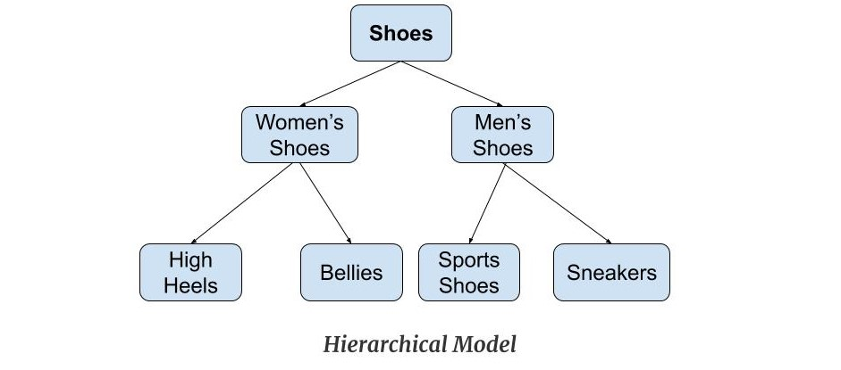
HIERARCHICAL DATABASE MODEL
Hierarchical database model resembles a tree structure, similar to a folder architecture in your computer system
The relationships between records are pre-defined in a one to one manner, between 'parent and child' nodes
They require the user to pass a hierarchy in order to access needed data

Slide 29
HIERARCHICAL DATABASE MODEL
Advantage
Disadvantage
The model allows you to easily add and delete new information.
Data at the top of the hierarchy can be accessed quickly.
This model works well with linear data storage mediums such as tapes.
Even though this model is conceptually simple and easy to design at the same time it is quite complex to implement
It has no standards as the implementation of this model does not provide any specific standard
This model also lacks flexibility as the changes in the new tables or segments

Slide 30
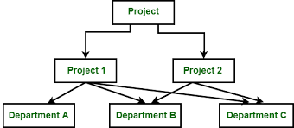
NETWORK DATA MODEL
This model was formalized by the Database Task group in the 1960s
This model is the generalization of the hierarchical model
This model can consist of multiple parent segments and these segments are grouped as levels but there exists a logical association between the segments belonging to any level
There exists a many-to-many logical association between any of the two segments

Slide 31
NETWORK DATA MODEL
Advantage
Disadvantage
This model is very simple and easy to design like the hierarchical data model.
This model is capable of handling multiple types of relationships which can help in modelling real-life applications, for example, 1: 1, 1: M, M: N relationships.
This network does not allow a member to exist without an owner which leads to the concept of Data integrity.
The schema or the structure of this database is very complex in nature as all the records are maintained by the use of pointers
The design or the structure of this model is not user-friendly
This model does not have any scope of automated query optimization

Slide 32
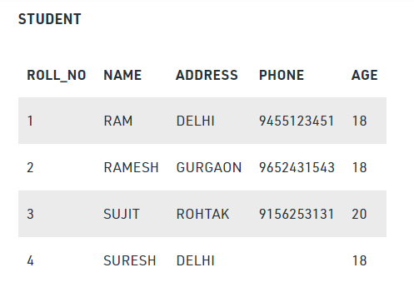
RELATIONAL DATA MODEL
Relational Model was proposed by E.F. Codd to model data in the form of relations or tables
A common type of database that stores data in tables, so it can be used in relation to other stored datasets
A relational database stores data in the form of relations (tables)

Slide 33
NETWORK DATA MODEL
Advantage
Disadvantage
Very less redundancy of data in this model
Normalization of database is possible in this model
Quick data processing
Table are interlinked with some common keys
We bind our database by various level of security
Very complex designs are made
(ER–diagram, schema diagram)
We got many rule to prepare data table so its not user friendly
Expensive to make and need extra storage

Slide 34
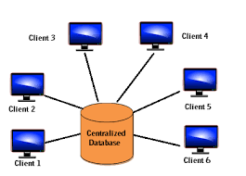
Centralized Database
A centralized database (sometimes abbreviated CDB) is a database that is located, stored, and maintained in a single location
Users access a centralized database through a computer network which is able to give them access to the central CPU, which in turn maintains to the database itself
Mainframe computer is the example of centralized database management system

Slide 35
Centralized Database
Advantage
Disadvantage
It allows for working on cross-functional projects
It is easier to share ideas across analysts
Higher levels of dependability are present within the system
Organizations can act with greater speed
t helps an organization stay close to a focused vision
It can become unresponsive to the needs of the business
It can have a negative impact on local morale
It may increase costs
There is a risk of loss

Slide 36
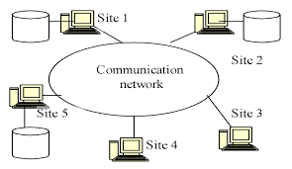
Distributed Database
A distributed database is a collection of multiple, logically interrelated databases distributed over a computer network
Database that is not limited to one system, it is spread over different sites
Distributed databases allow local users to manage and access the data in the local databases while providing some sort of global data management which provides global users with a global view of the data

Slide 37
Distributed Database
Advantage
Disadvantage
Modular Development( Plant on various location)
More Reliable( If one crashes another is running)
Better Response( Faster to locate due to regional servers)
Lower Communication Cost (Regional Server helps to communication cost on cheaper way)
Improved share ability and local autonomy
Cost( More the server more expensive it becomes)
Security( Very hard to save our data)
Database design more complex( Our data are fragmented and stored)
More difficult to handle ( We may get some threats )

Slide 38
Difference Between Centralized and Distributed Database
 | Centralized database | Distributed database
1. | It is a database that is stored, located as well as maintained at a single location only. | It is a database which consists of multiple databases which are connected with each other and are spread across different physical locations.
2. | The data access time in the case of multiple users is more in a centralized database. | The data access time in the case of multiple users is less in a distributed database.
3. | The management, modification, and backup of this database are easier as the entire data is present at the same location. | The management, modification, and backup of this database are very difficult as it is spread across different physical locations.
4. | This database provides a uniform and complete view to the user. | Since it is spread across different locations thus it is difficult to provide a uniform view to the user.
5. | This database has more data consistency in comparison to distributed database. | This database may have some data replications thus data consistency is less.
6. | The users cannot access the database in case of database failure occurs. | In distributed database, if one database fails users have access to other databases.
7. | Centralized database is less costly. | This database is very expensive.

Slide 39
Database Security
Database security refers to the range of tools, controls, and measures designed to establish and preserve database confidentiality, integrity, and availability
Database security procedures are aimed at protecting not just the data inside the database, but the database management system and all the applications that access it from intrusion, misuse of data, and damage
Database security is generally planned, implemented and maintained by a database administrator and or other information security professional
We use various encryption technique to make our database more secure and phishing can be avoided

Slide 40
Importance of Database Security
Compromised intellectual property
Damage to brand reputation
Business continuity
Costs of repairing breaches and notifying customers

Slide 41
Some Challenges on Database Security
Insider threats
Human error
Exploitation of database software vulnerabilities
Buffer overflow exploitations
Denial of service (DoS/DDoS) attacks
Malware

Slide 42
Security Measured at several Level
Database System Level (Allowing Access of DBMS)
Operating System Level (Login Credentials and roles)
Network Level (Website Security)
Physical Level (Locking by lock door windows, earthquake and other)
Human Level (Finger Lock and choosing best security)

Slide 43
NORMALIZATION
Normalization is the process of minimizing redundancy from a relation or set of relations
It also eliminates redundancy and increases the integrity which improves performance of the query
Organizing non structured data in to structured data
Normalization is used for mainly two purposes,
  Eliminating redundant(useless) data.
  Ensuring data dependencies make sense i.e. data is logically stored.
1NF : Makes all table in an atomic values
2NF : The relation in second normal form is also in first normal form and no partial dependencies on any column in primary key
3NF : Be in 2NF and Has no transitive functional dependencies and To move our 2NF table into 3NF, we again need to again divide our table

Slide 44
Advantage of Normalization
It eliminates data redundancy i.e. duplication of data.
It enhances faster sorting and index creation.
It simplifies the complex structure of tables.
It avoid loss of data through consistency and integrity.
It solves insertion, deletion and updating anomalies.
It improves the performance of a system.

Slide 45
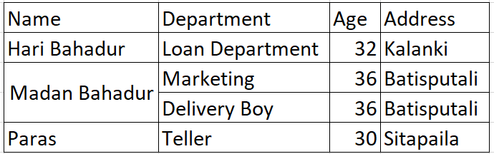
Un Normalized Table
Employee_table

Slide 46
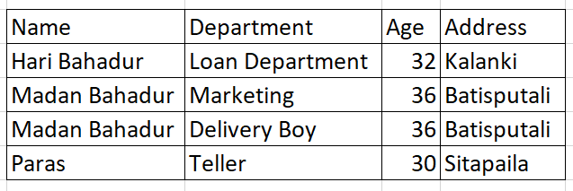
1NF
Now we make our data attributes atomic i.e. we don’t have double data for a single values
Employee_table
Now each Name has an separate department in our database
By this we make our data values atomic
But there is still data redundancy so we move to next step

Slide 47
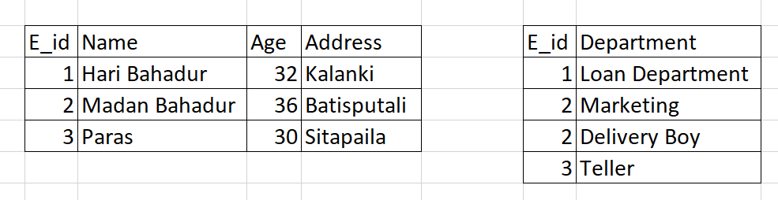
2NF
We introduce primary keys and secondary keys in our database
WE make two separate tables and link them by primary and foreign keys
We try to remove functional dependency
Employee_ info _table
Employee_with_department_table
Since department, age , address depends upon name
So we create new table where we create an department list table with department assignment and Employee Detail Table
But we got a problem (if we delete any one of Employee Detail then Department will be also delete

Slide 48
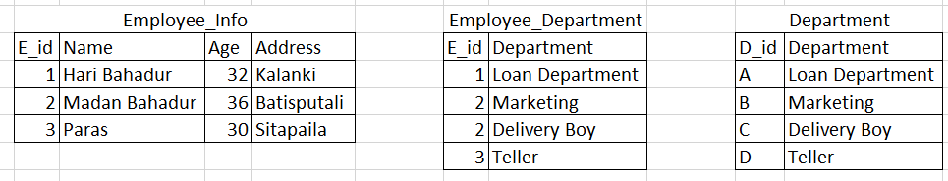
3NF
Now we make one more extra table to overcome some functional dependency and data lost
We add one more table in which we give code to our department and link with primary and secondary keys
Now if anyone of employee left then our data of department wont be lost because we got separate table where we store our department lists
We don’t have transitive functional dependency

